Slide 1
Conservation of lake water and reduction of contaminated water
By : Bhavani.N.Raj , Kangana.M , Diganth.N of Grade IX
Vagdevi Vilas School, Nelamangala

Slide 2
INTRODUCTION
Lake has been a major water resource for people in the olden days
Nowadays , people are reluctant to use lake water for domestic purposes
People are neglecting the importance of lake water and constantly harming and contaminating the water

Slide 3
OBJECTIVES
Study of lake water quality
To analyze physical and chemical parameters
Preventing the lake water from being contaminated
Approach towards cleaning the water

Slide 4
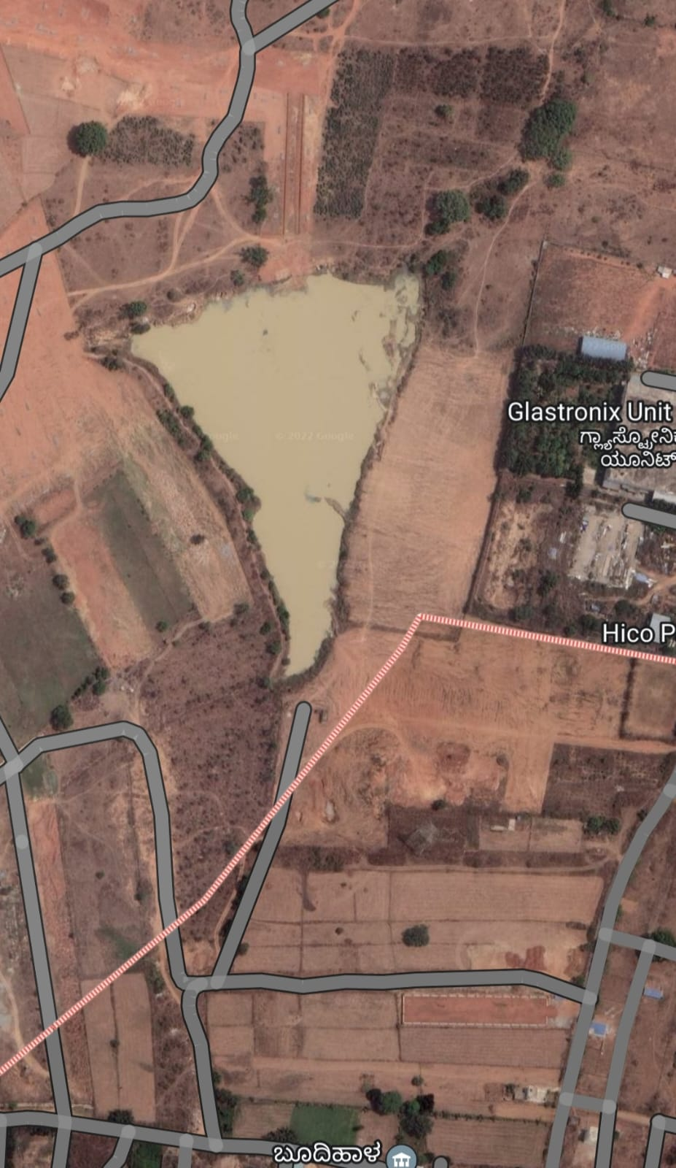
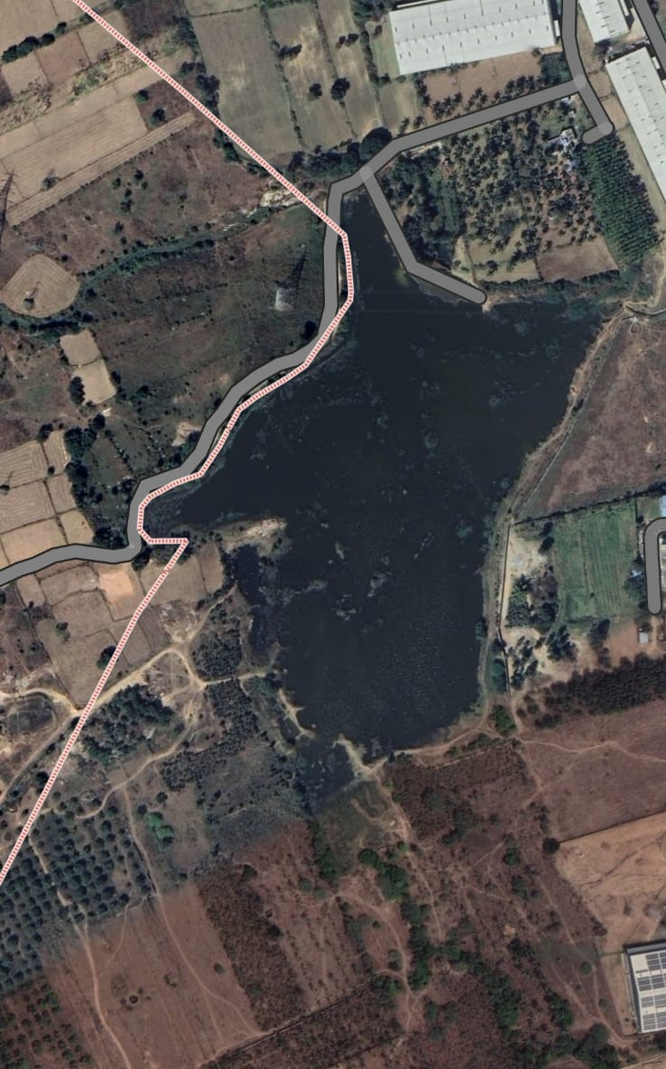
MAPPING

Slide 5
CONTRIBUTION OF LAKE TO OUR ECOSYSTEM
Useful for agriculture
Home for many animals , plants and birds
Useful for animals as drinking water

Slide 6
HOW IS LAKE WATER BEING CONTAMINATED?
human activities
sewage disposal
industrial waste

Slide 7
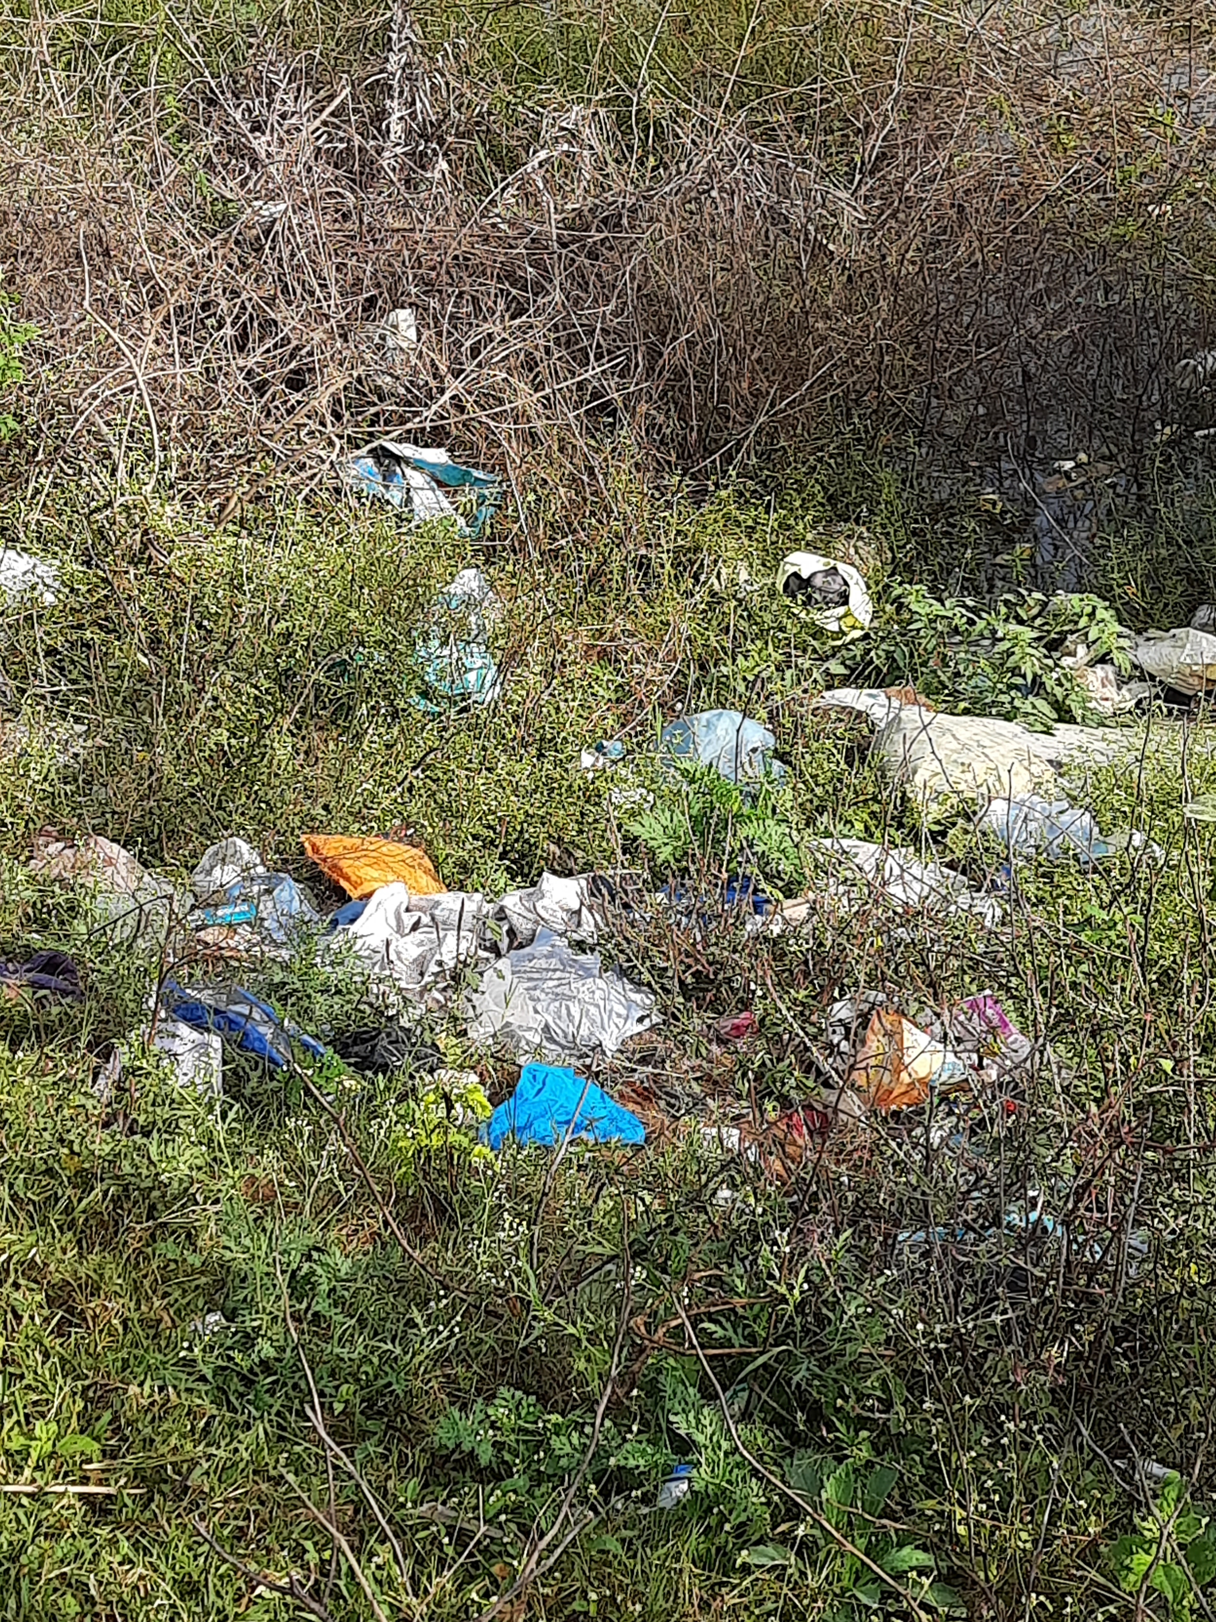
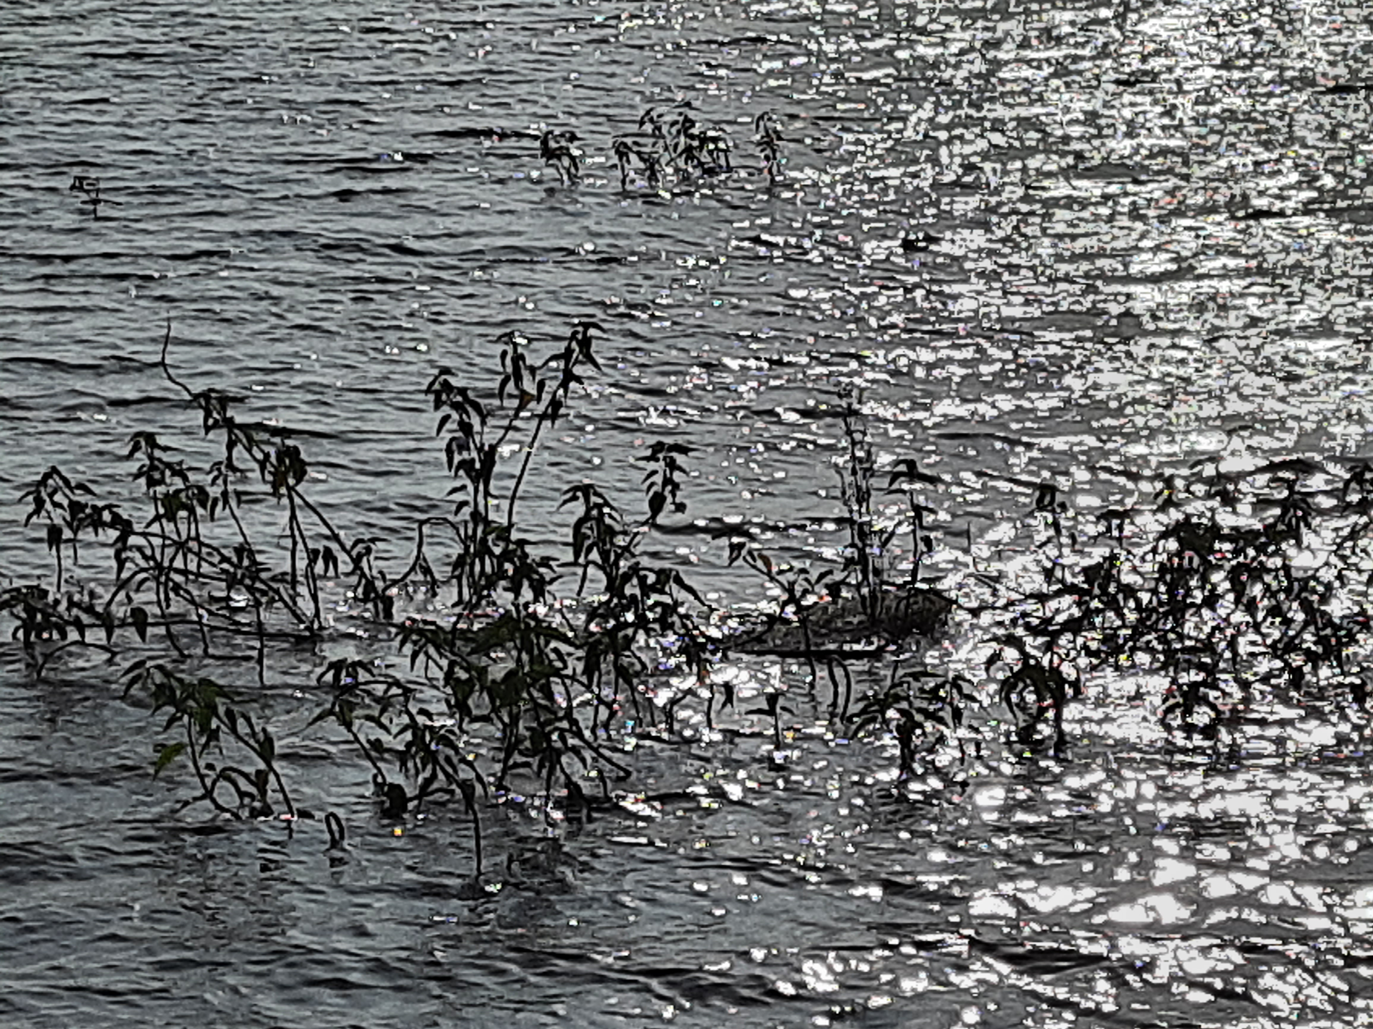
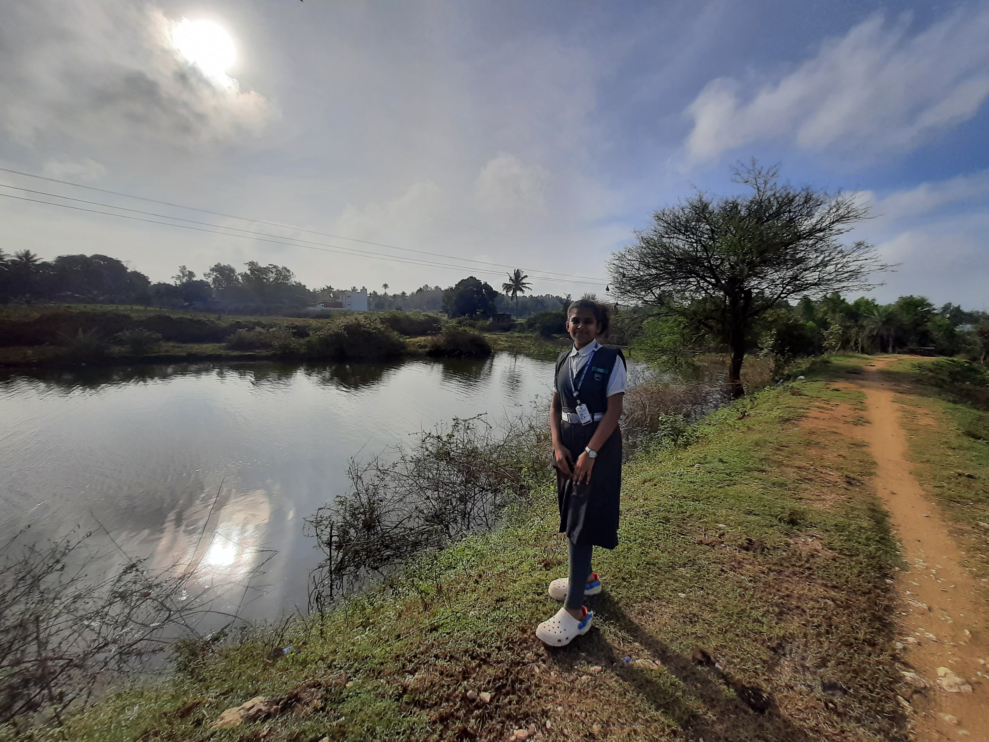
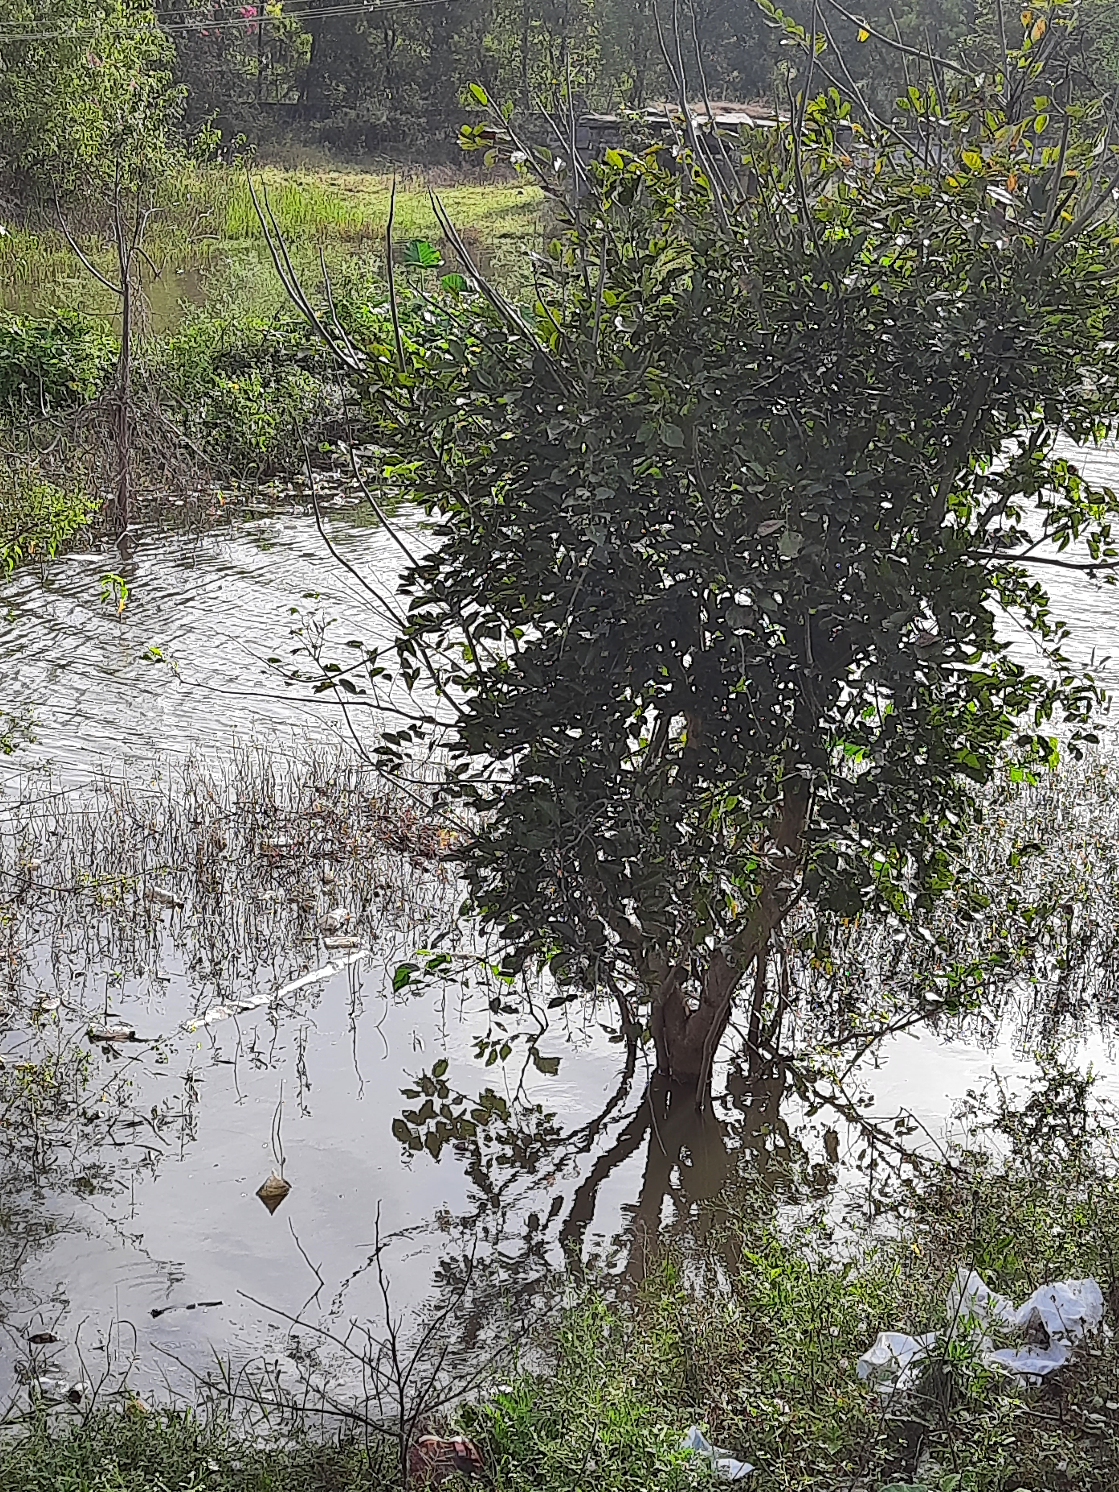
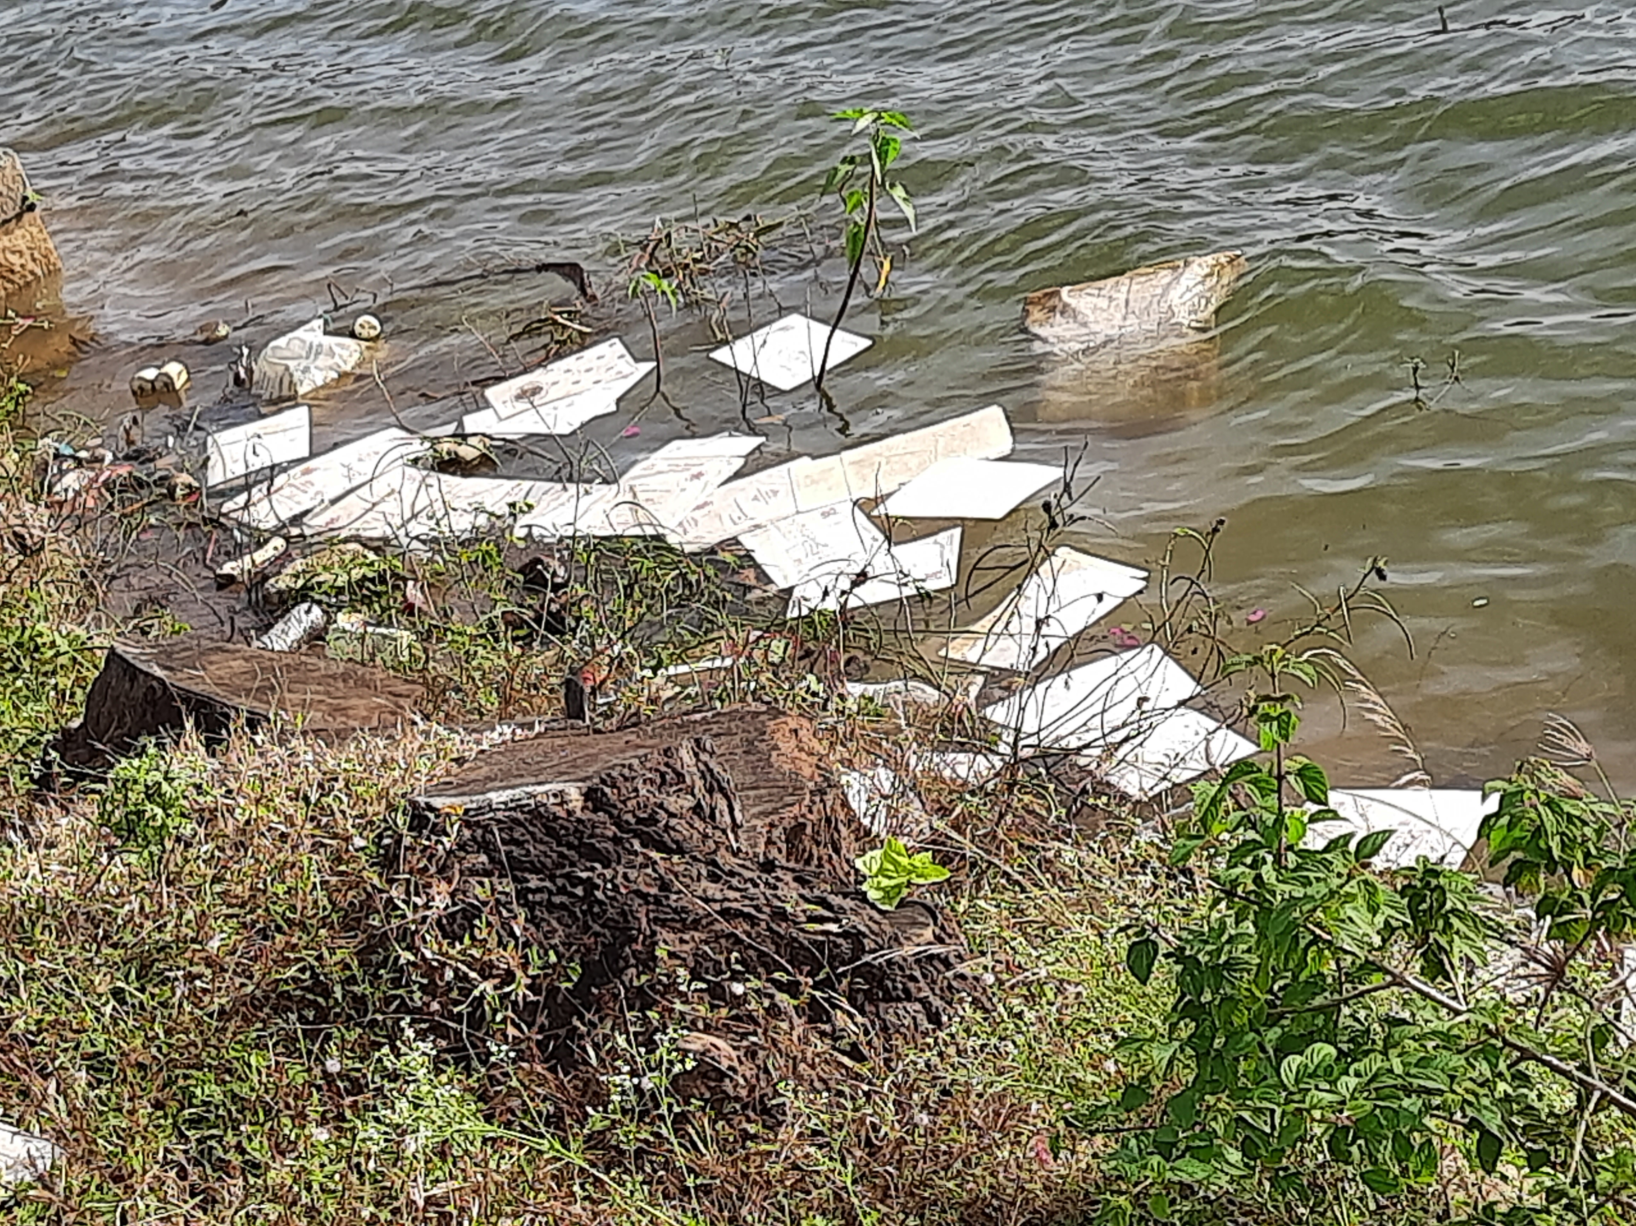
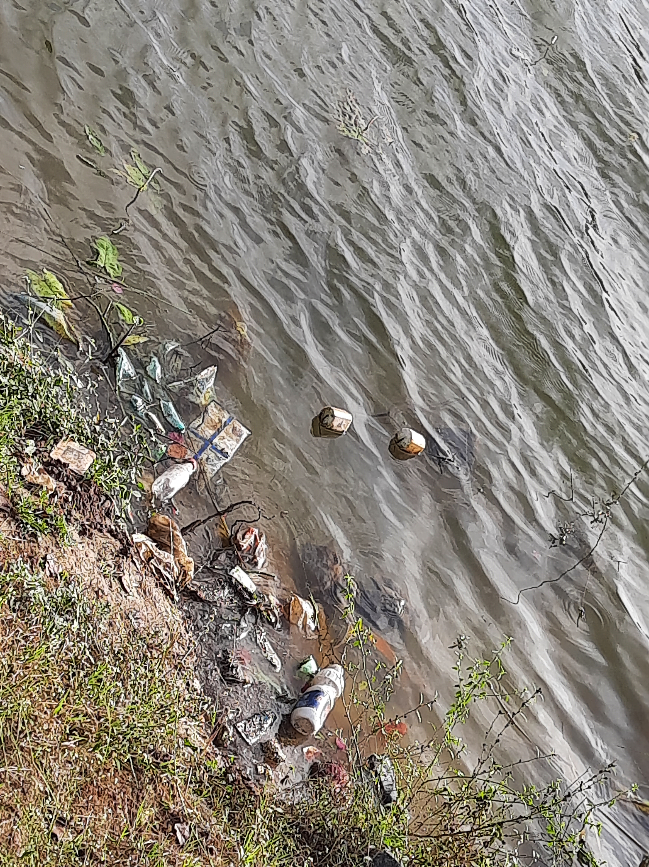
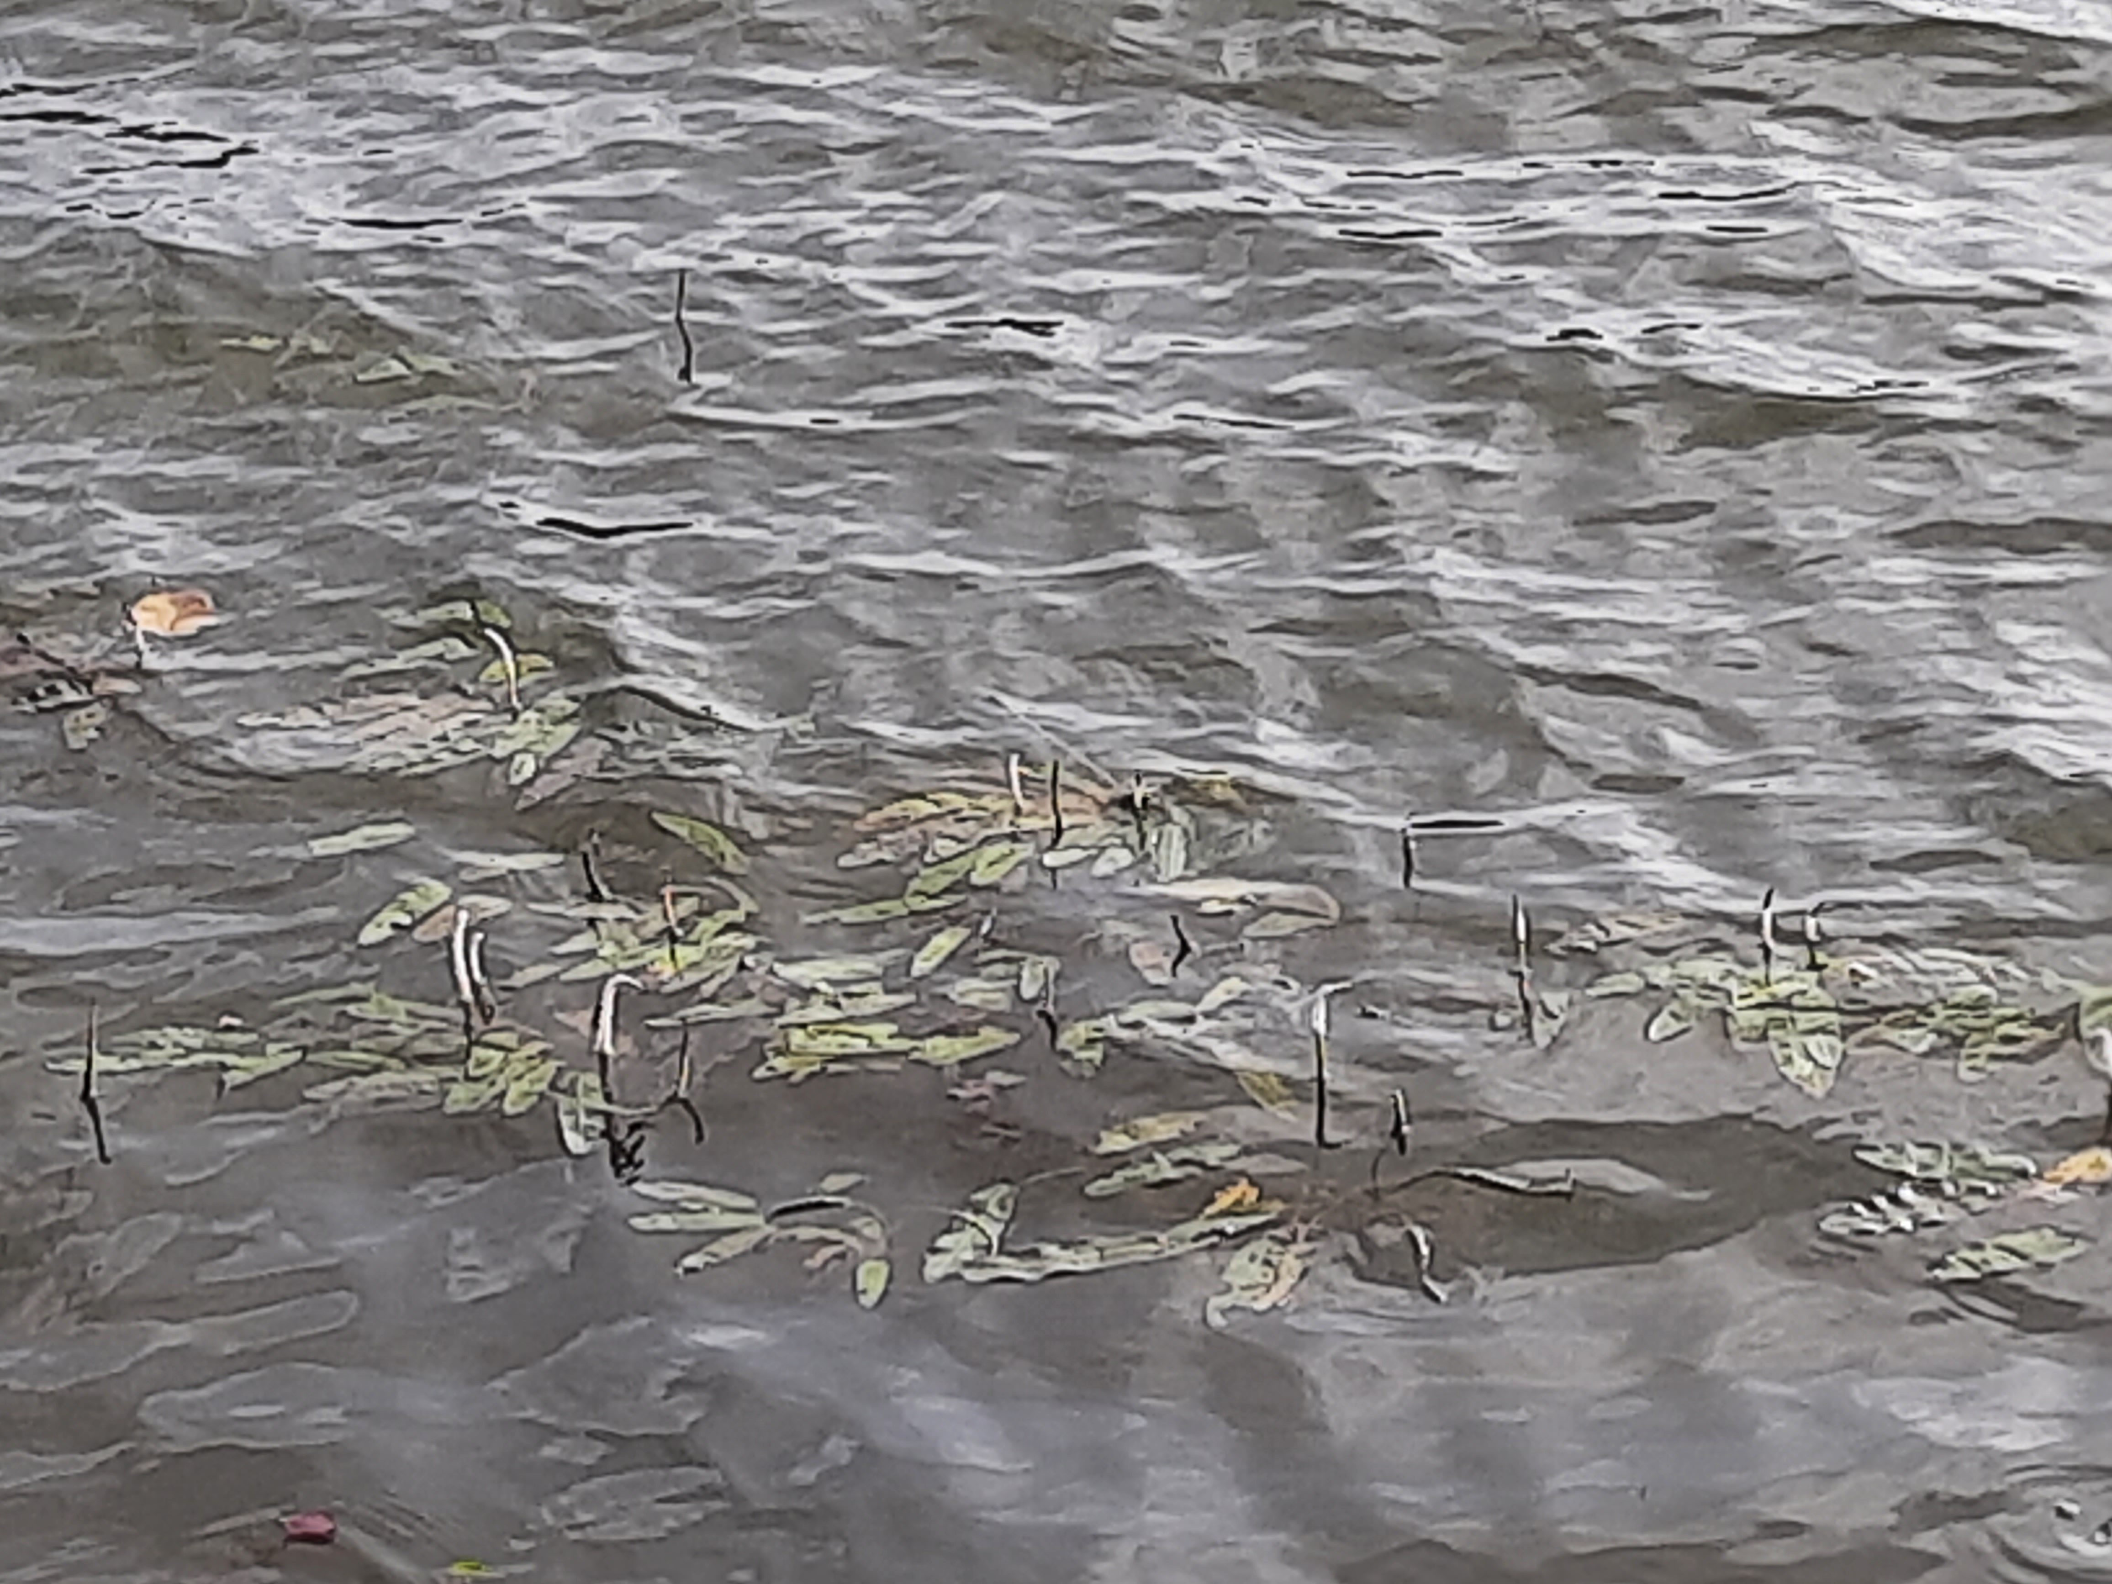
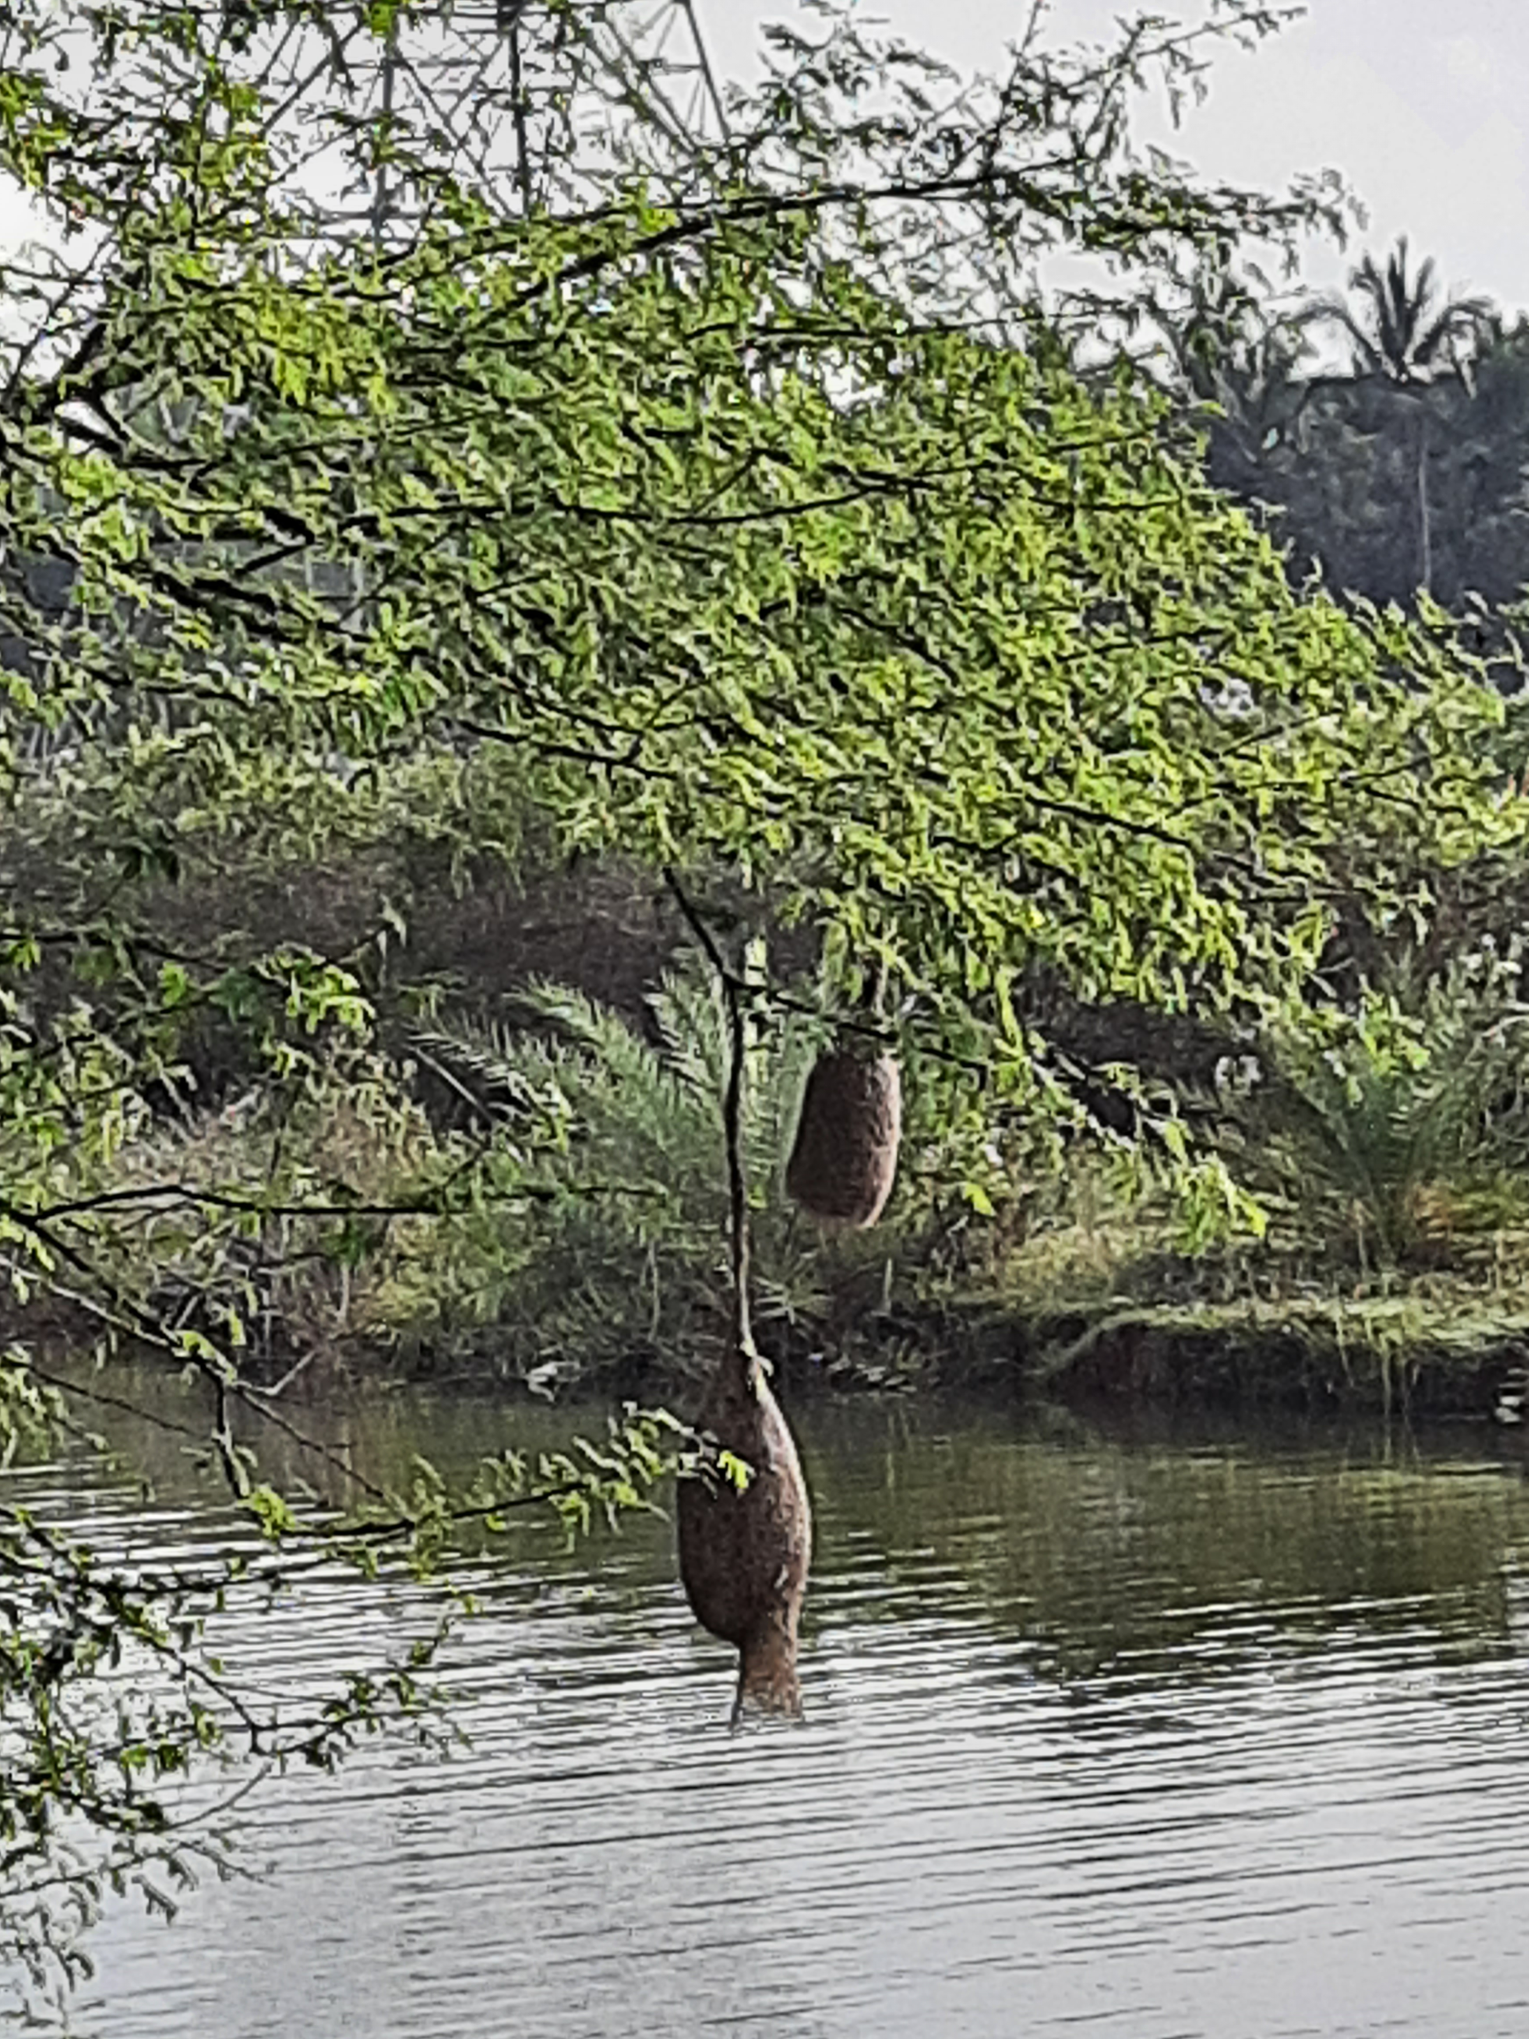
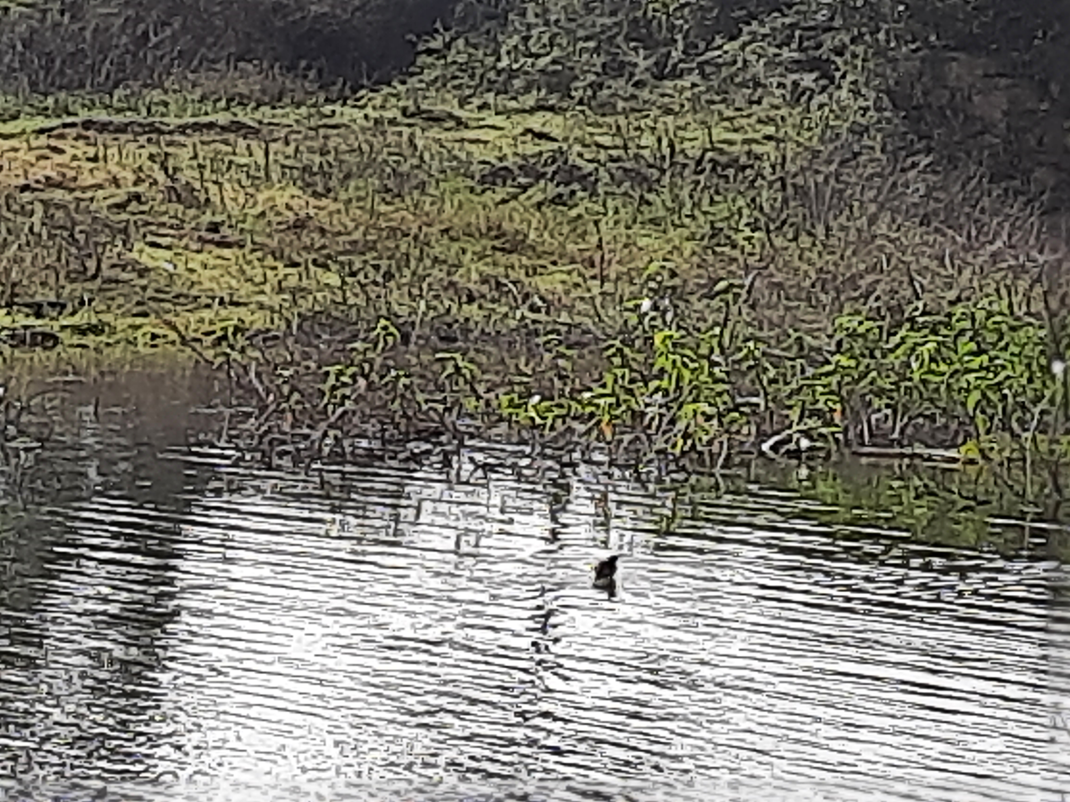
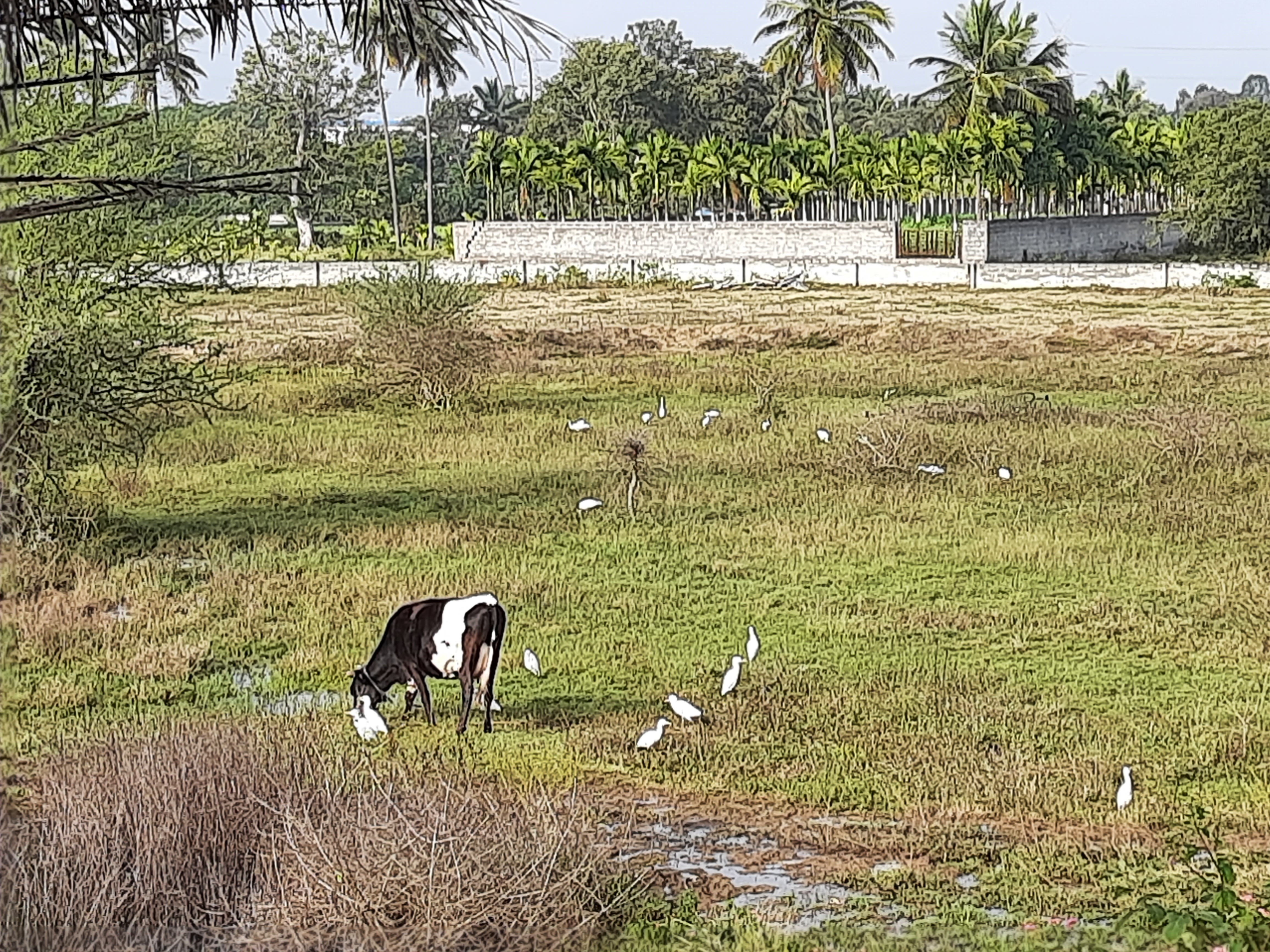
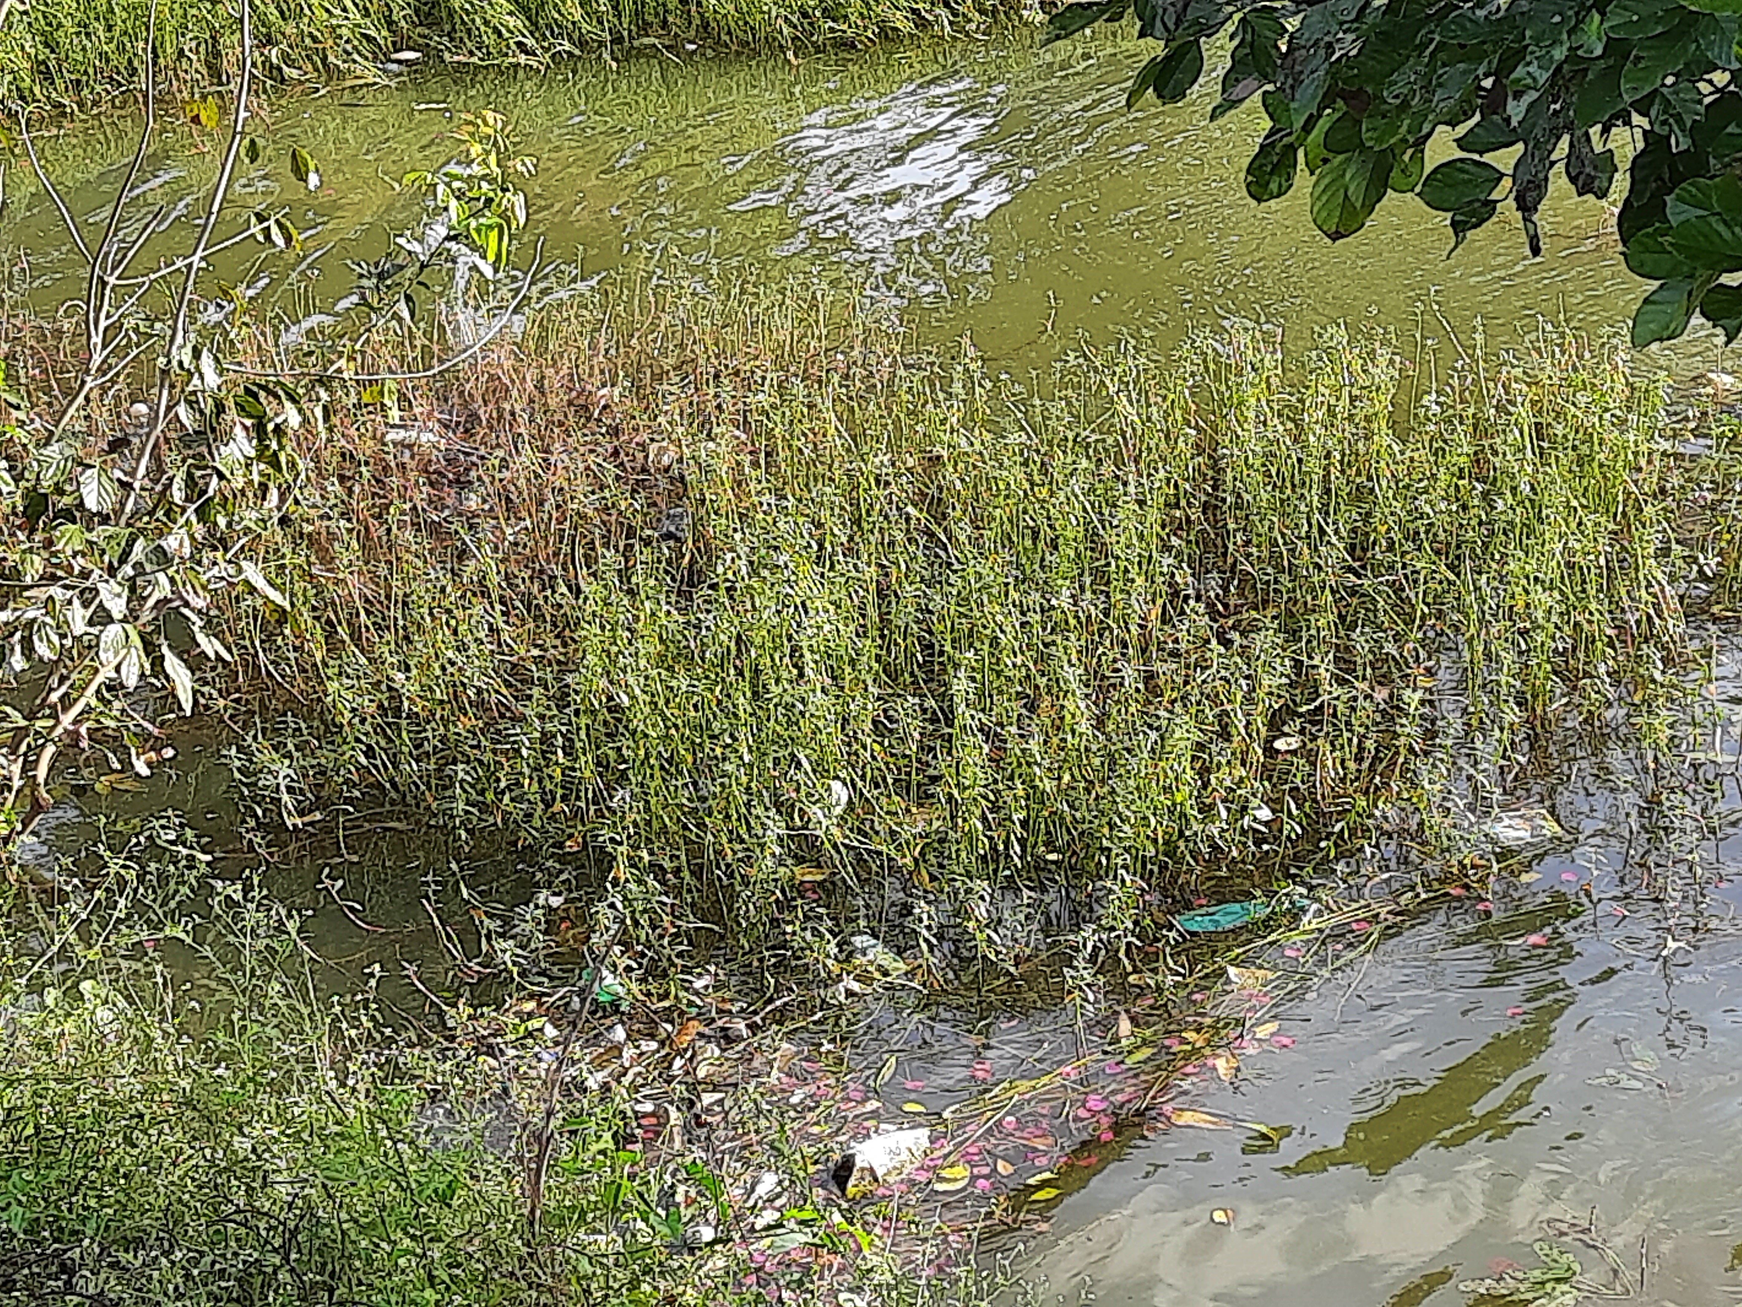
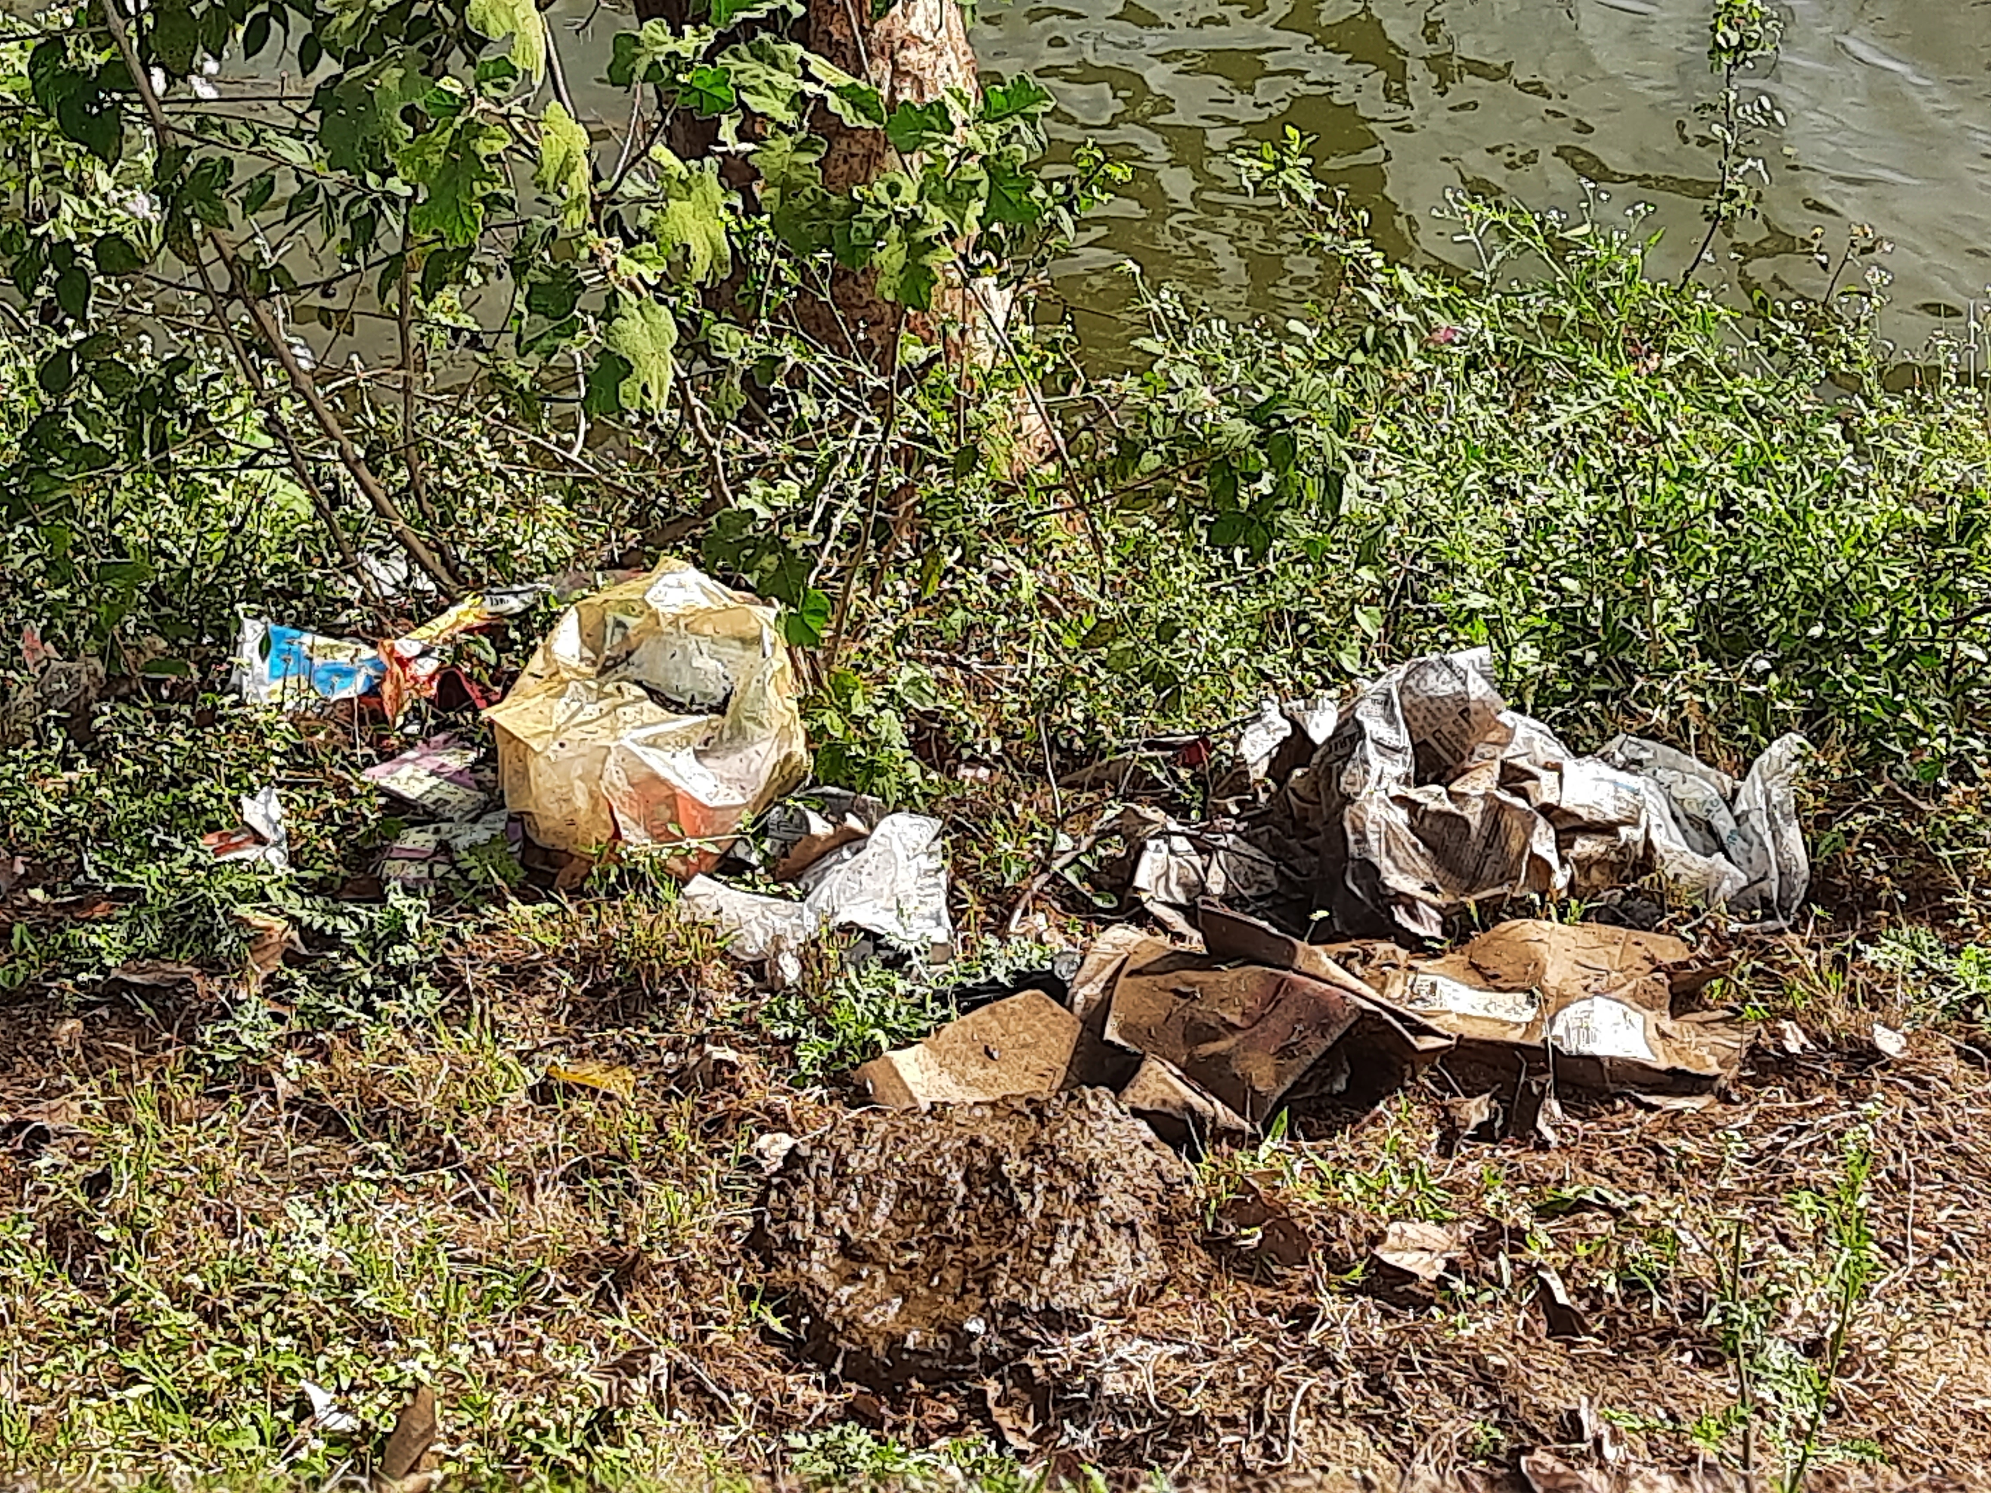
BUDIHAL LAKE

Slide 8
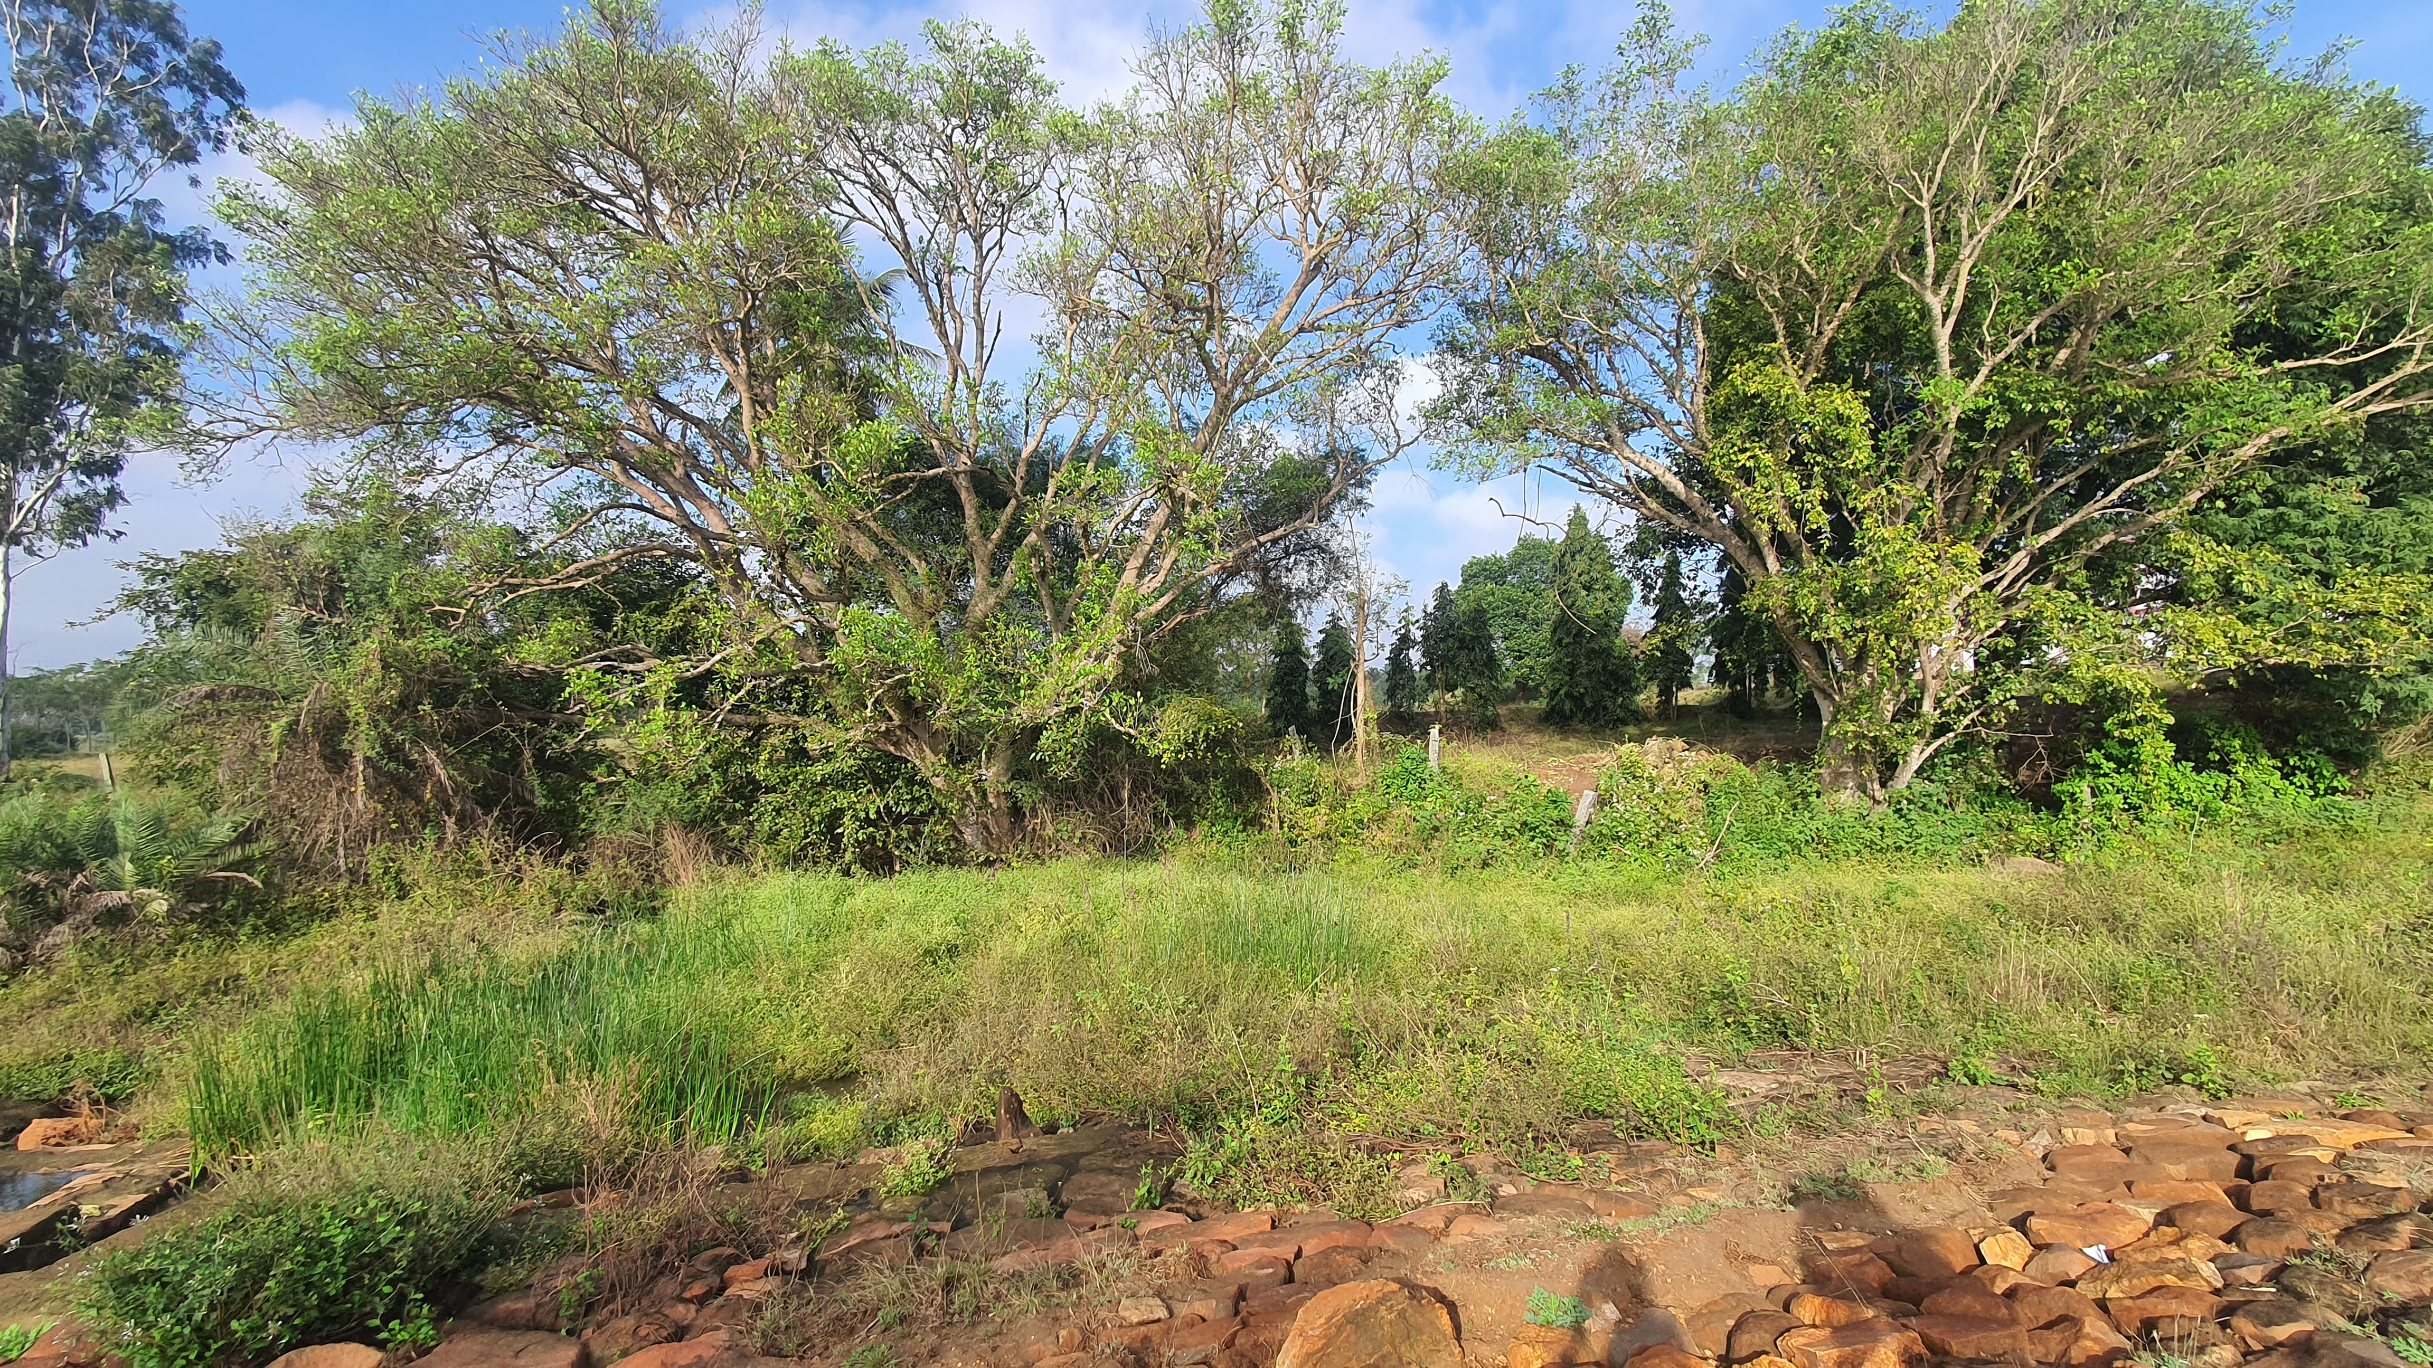
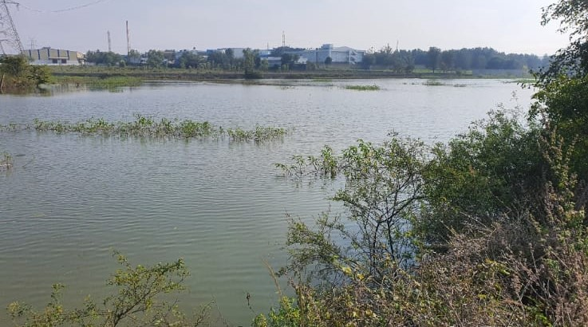
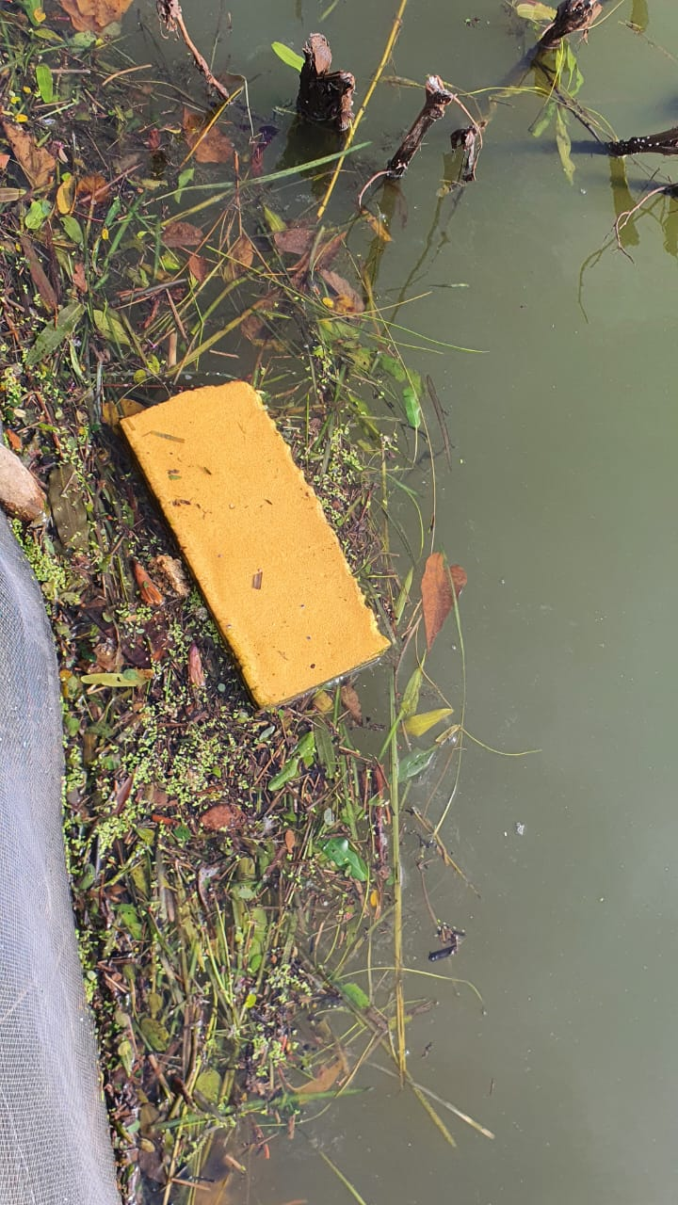
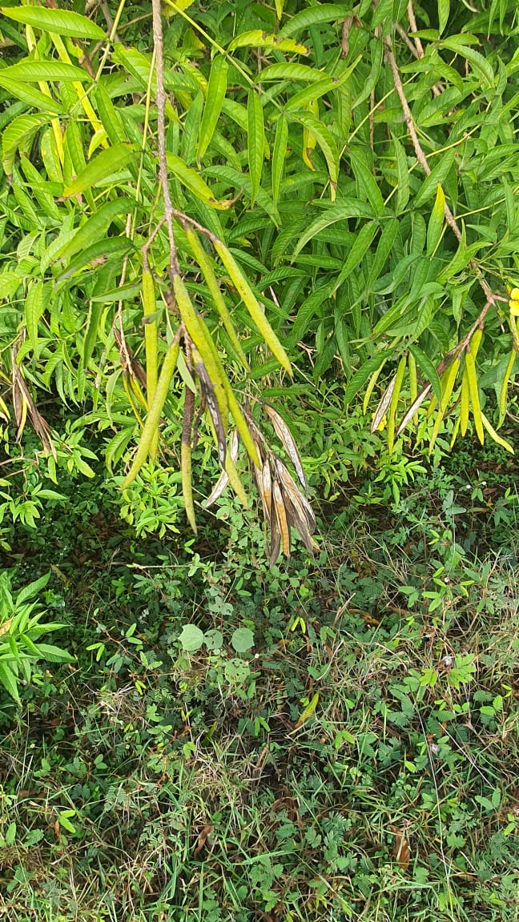
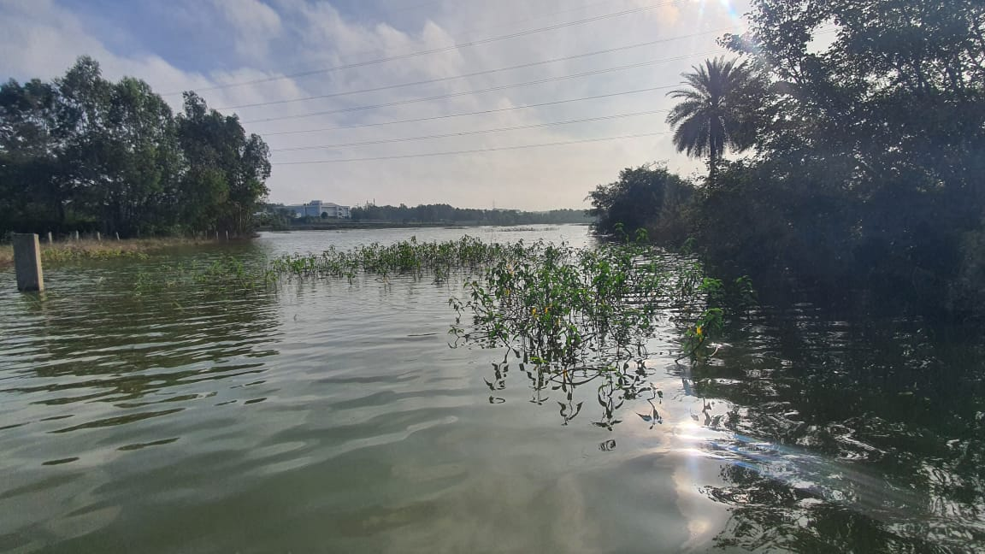
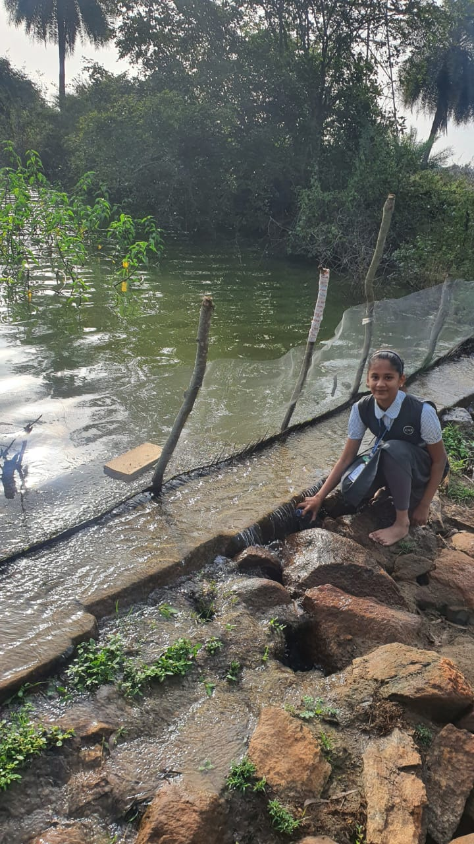
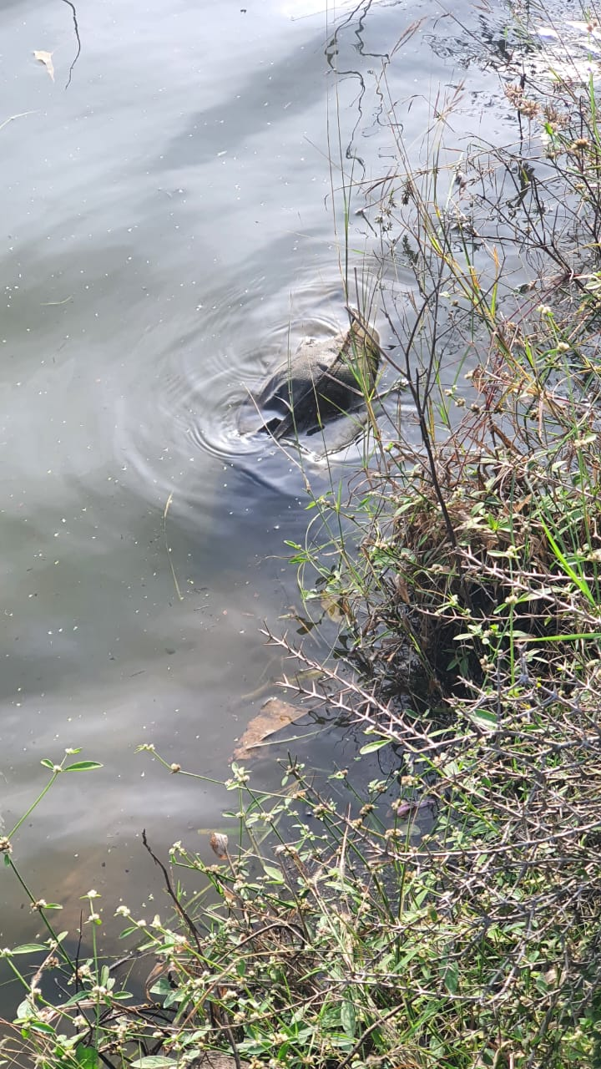
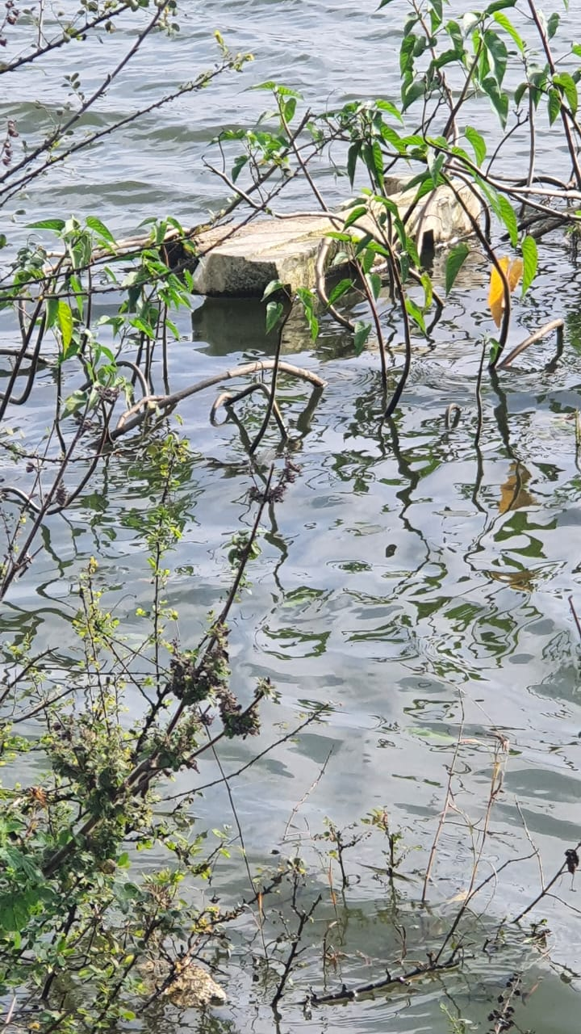
HURULIHALLI LAKE

Slide 9
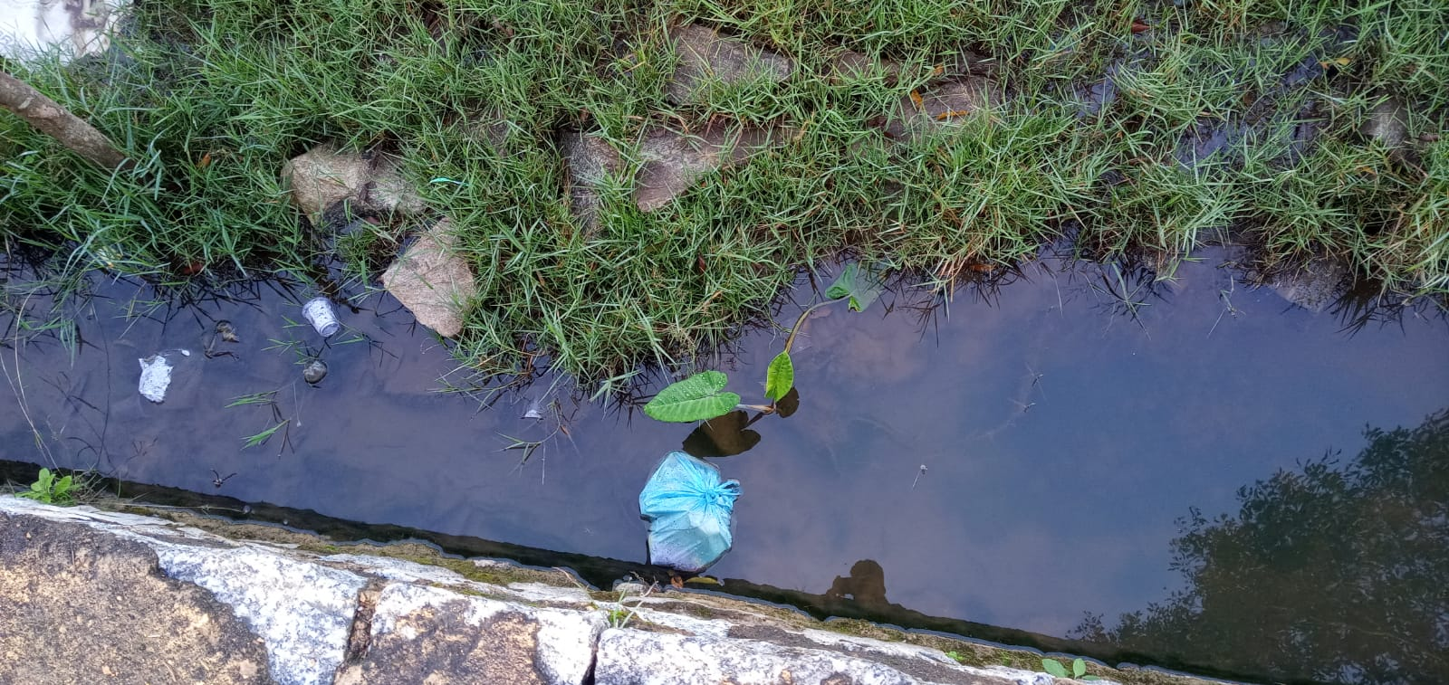
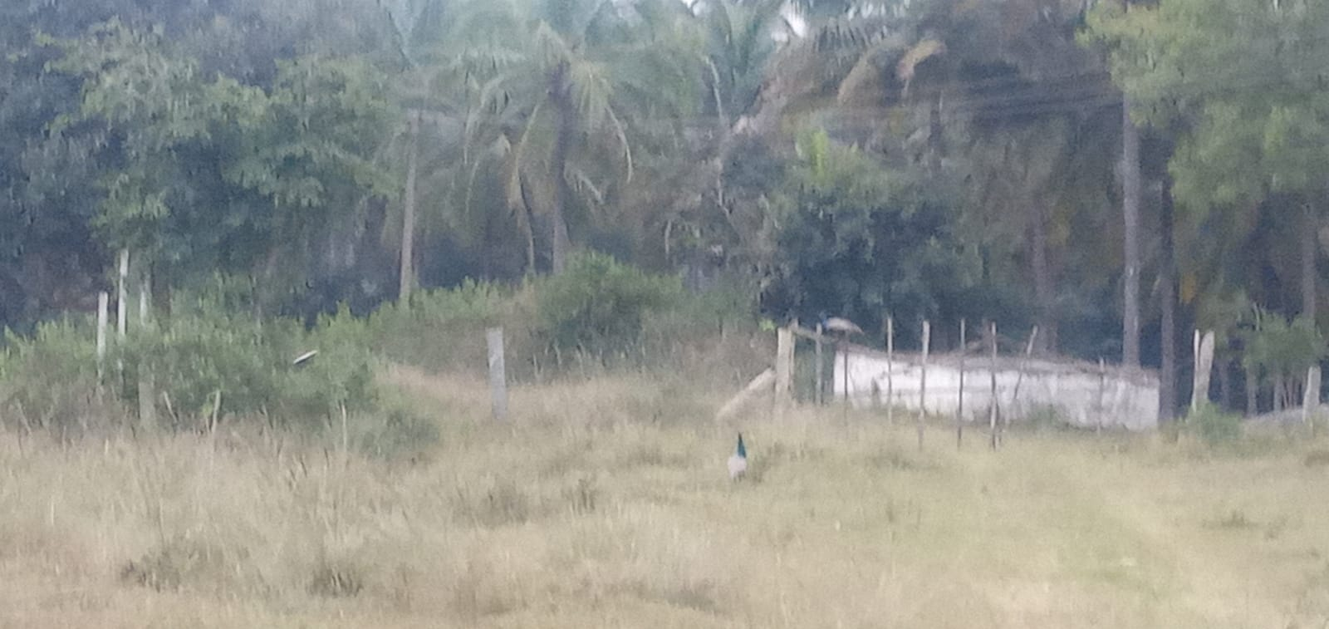
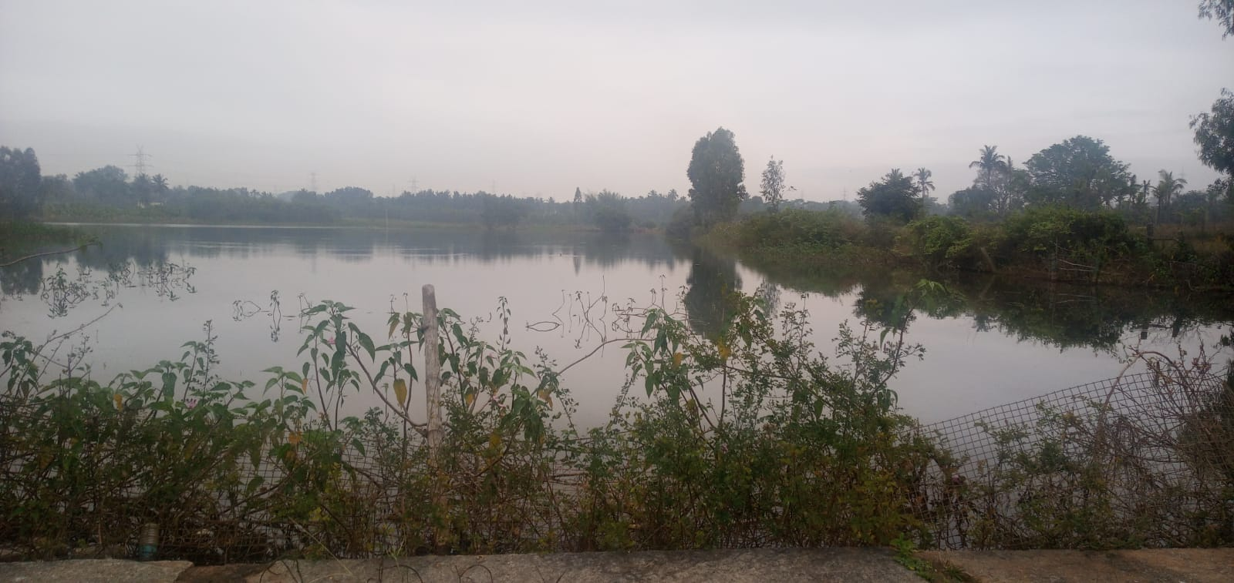
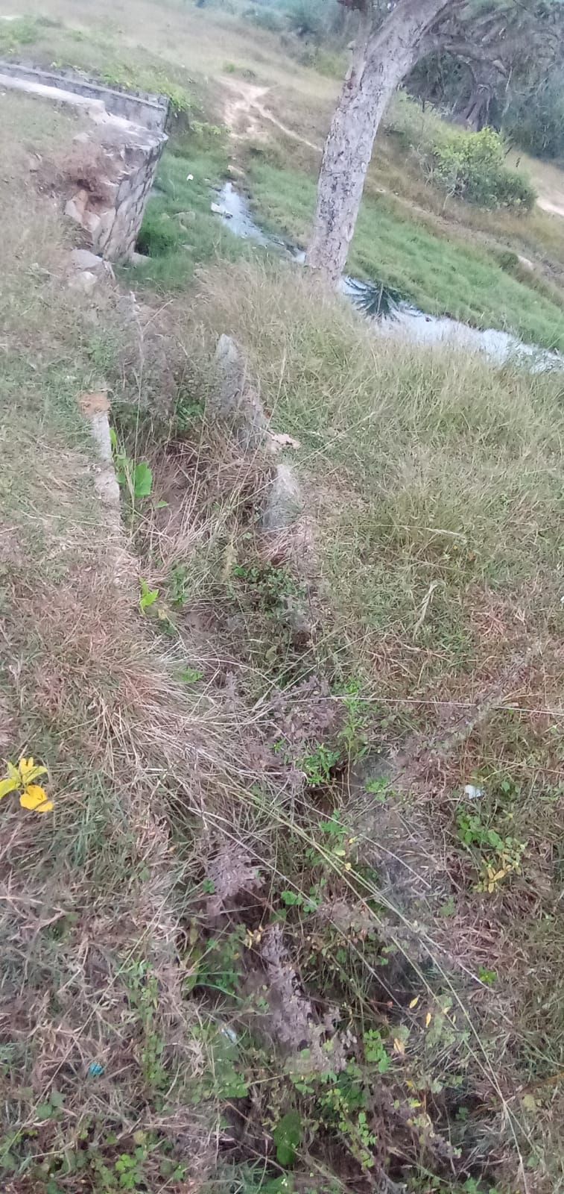
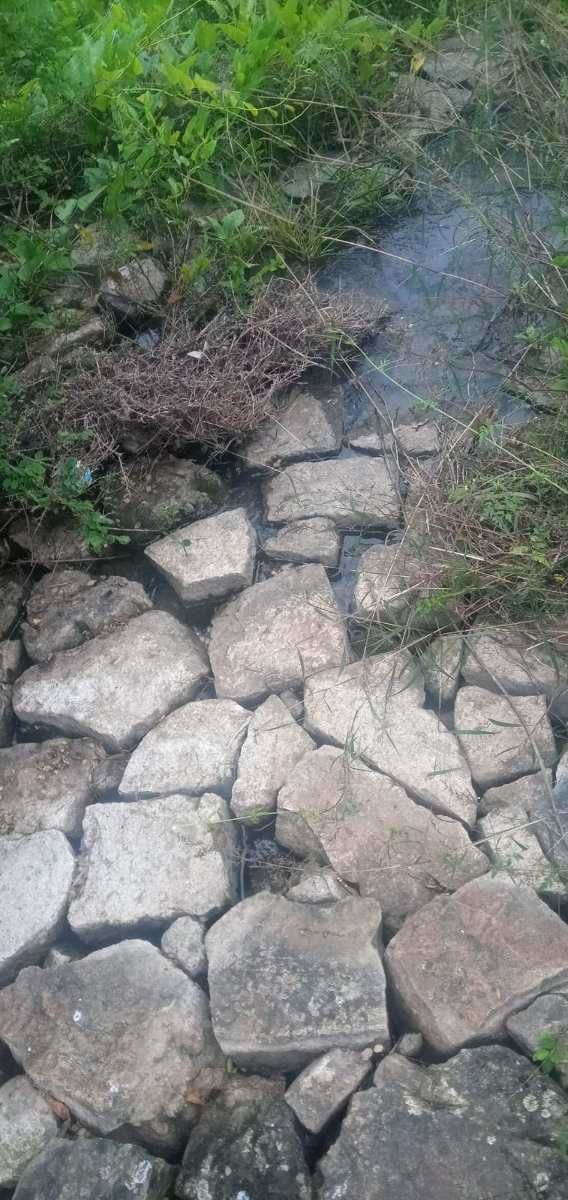
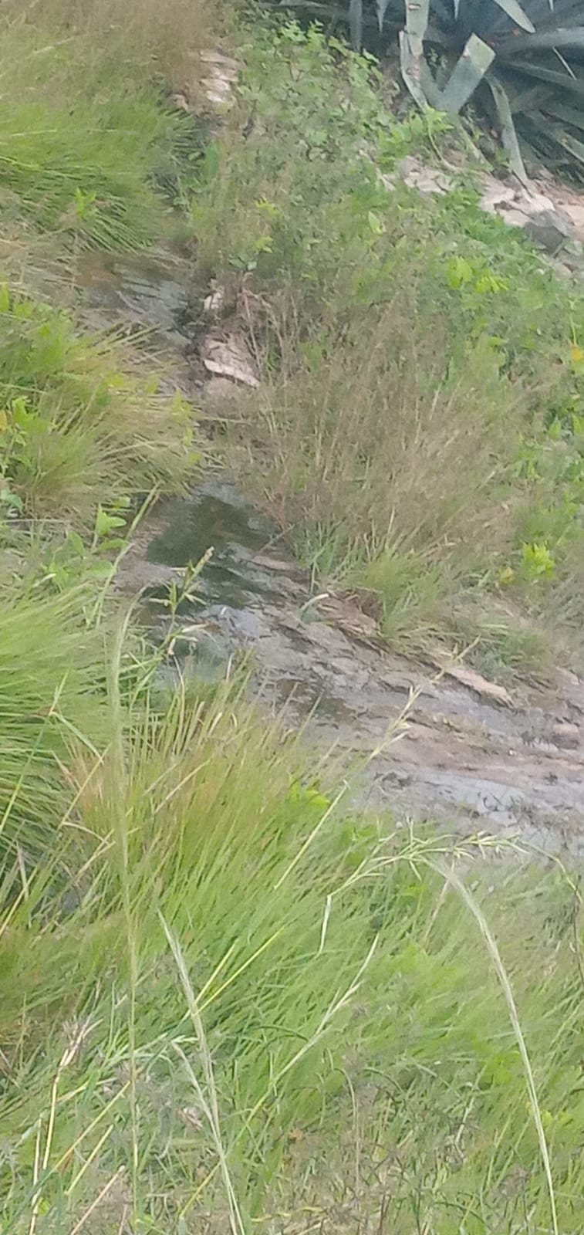
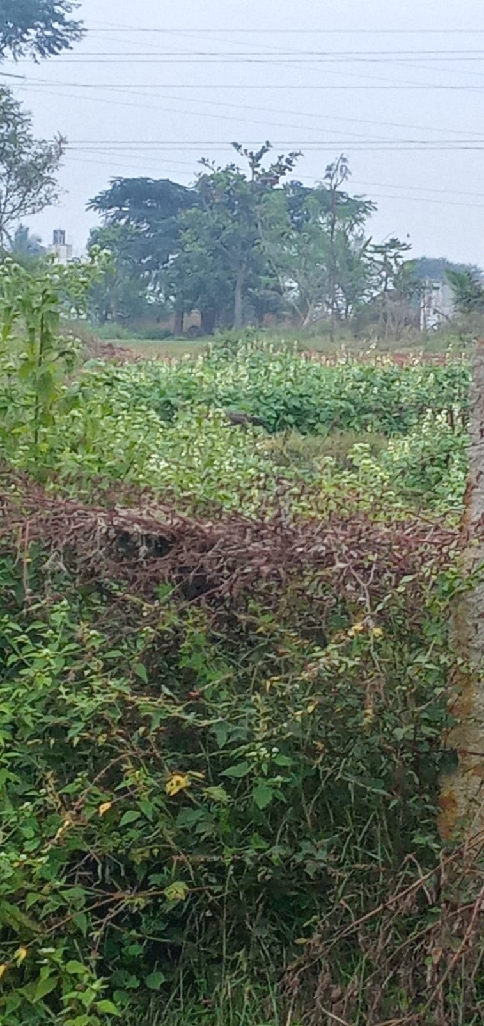
HULLEGOWDANAHALLI LAKE

Slide 10
MACROPHYTES
Name : Tania
Scientific name : Xanthosoma sagittifolium
Name : smooth rose mallow
Scientific name : Hibiscus laevis
Name : White/Grey Mangrove
Scientific Name : Avicennia Marina

Slide 11
On site Parameters
 | Budhihal | Hullegowdanahalli | Hurulihalli
Odor | Lightly algaeish smell | No odor | Lightly algaeish smell
Color | Light green | Colorless | Pale green

Slide 12
Comparison of Chemical Parameters
 | Standard values | Budhihal | Hullegowdanahalli | Hurulihalli
pH value | 7 | 8 | 9 | 7
Turbidity | 5 NTU | 13-14 NTU | 25-26 NTU | 22-23 NTU
Residual chlorine | 0.2 - 0.5 mg/l | 0.1 mg/l | 0.2 mg/l | 0.1 mg/l
Hardness | Below 75 mg/l | 20 mg/l | 50 mg/l | 40 mg/l
Chloride | 1000 mg/l | 710 mg/l | 3550 mg/l | 1420 mg/l

Slide 13
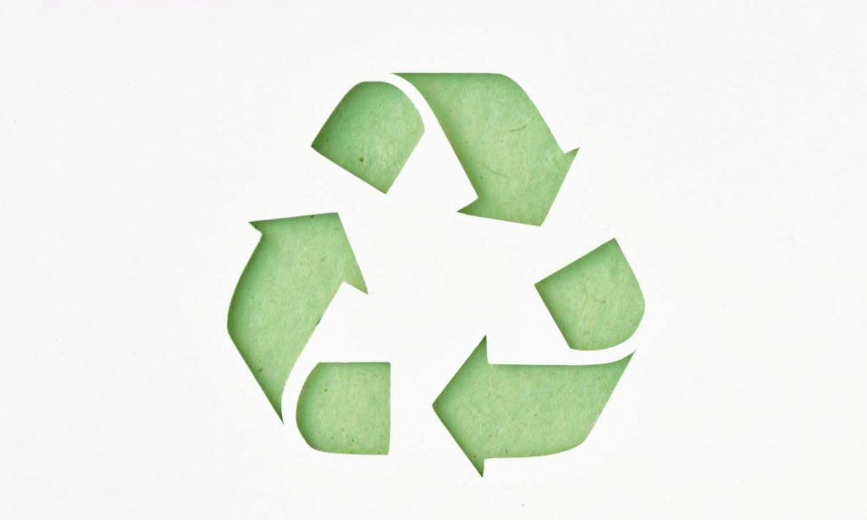
PHYSICAL APPROACH TOWARDS CLEANING THE LAKE WATER
Plant more trees
Reduce the waste
Stop constructing chemical factories
Avoid the disposal of plastics into lakes
Avoid discharging sewage water into the lakes
Stop disposing medicinal waste into the lakes

Slide 14
CONCLUSION
Lake is a main stay of water.
Conserve the lake water and stop contaminating and polluting it.
We can clean these pollutants by using simple methods.
Methods which we have thought and approached are very simple and can be implemented by everyone.
They are economical and environment friendly.

Slide 15
ACKNOWLEDGEMENT
Villagers
R&D teachers
Parents
IISC

